Slide 1
CEIS106 Operating Systems
By: Vouthanack Sovann

Slide 2
Introduction
Fundamentals of Linux directory creation
Fundamentals of access controls
Basic addition and removal of user groups
Network monitoring and performance basics

Slide 3
Operating Systems

Slide 4
Navigate the Linux filesystem tree
1. What is the pwd command an acronym for? What about the cd command?
pwd: Print Working Directory
cd: Change Directory
2. Explain the differences between a relative path and an absolute/full path in Linux.
Relative Path - is defined as the path related to the present working directly(pwd). It starts at your current directory and never starts with a / .
Absolute Path - The Absolute path always starts from the root directory (/). For example, /home/abhishek/scripts/my_scripts.sh.

Slide 5
Create directories and files

Slide 6
Copy and remove directories and files

Slide 7
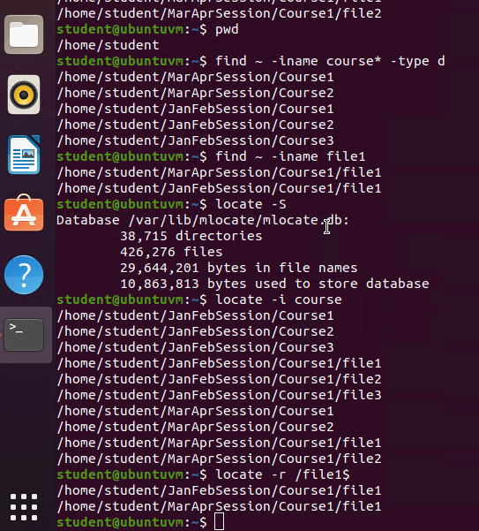
Locate directories and files

Slide 8
Linux Shell Scripts

Slide 9
CREATE A SHELL SCRIPT
What are the file permissions of the script?
rw- for the owner – read and write only access (no execute)
rw- for the group – read and write only access (no execute)
r – for everyone else – read only (no write, no execute)
2. What’s the name of the user-defined variable in the script?
text
3. Which redirection meta-character is used in the script? What does it do?
>> -- redirects the output file and appends to the file (single arrow, > , will overwrite the file)

Slide 10
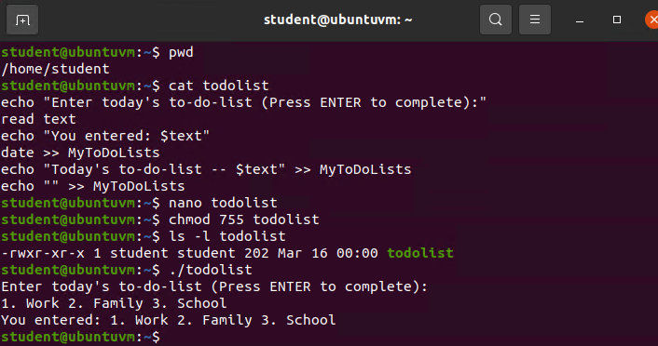
Change script file permissions

Slide 11
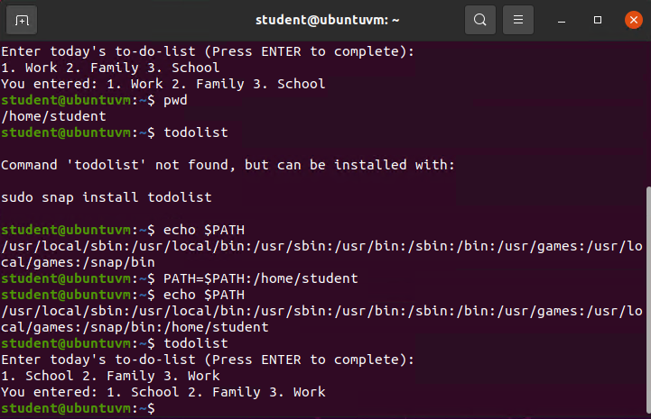
Set the PATH variable

Slide 12
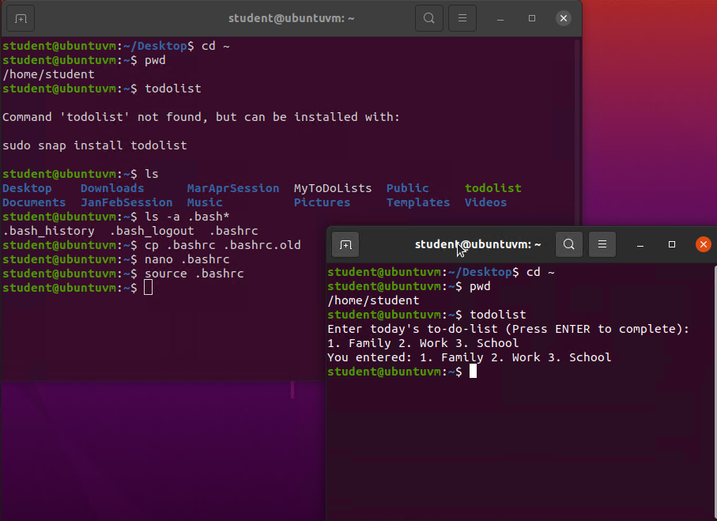
Make the PATH variable permanent

Slide 13
User and Group Management

Slide 14
Add users and groups in CLI
1. What does the –m option in the useradd command do?
Creates a home directory for the newly created user.
2. What does the -3 option in the tail command do?
It displays the last three lines of the file.
3. Which line of the /etc/group file lists members of the “students” group?

Slide 15
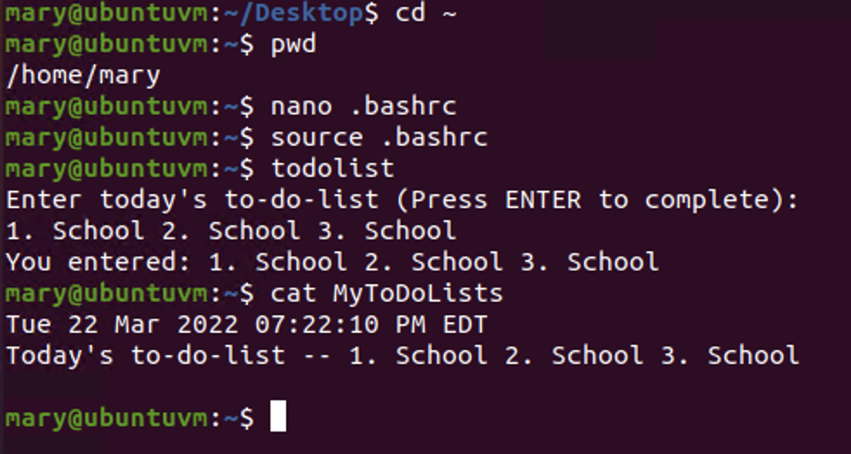
Test user and group settings

Slide 16
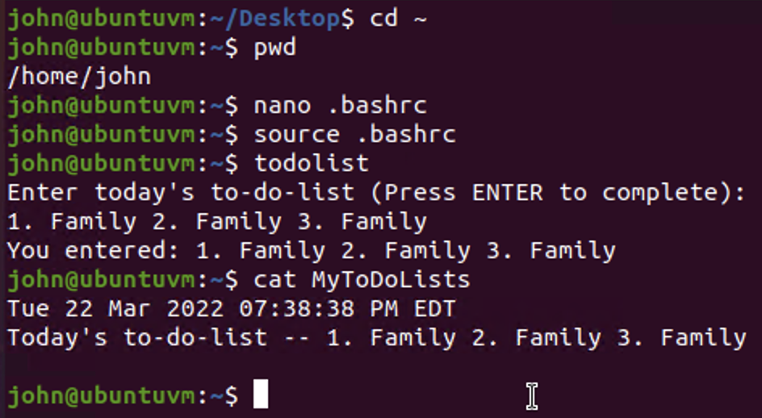
Add users in GUI

Slide 17
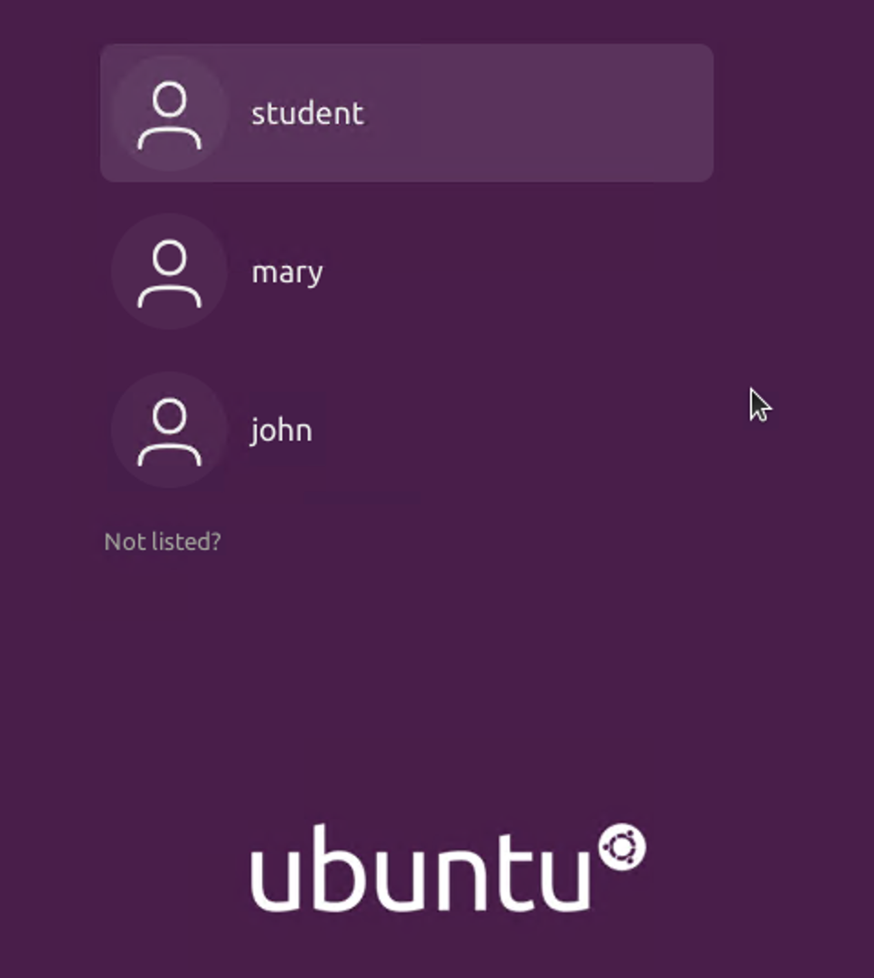
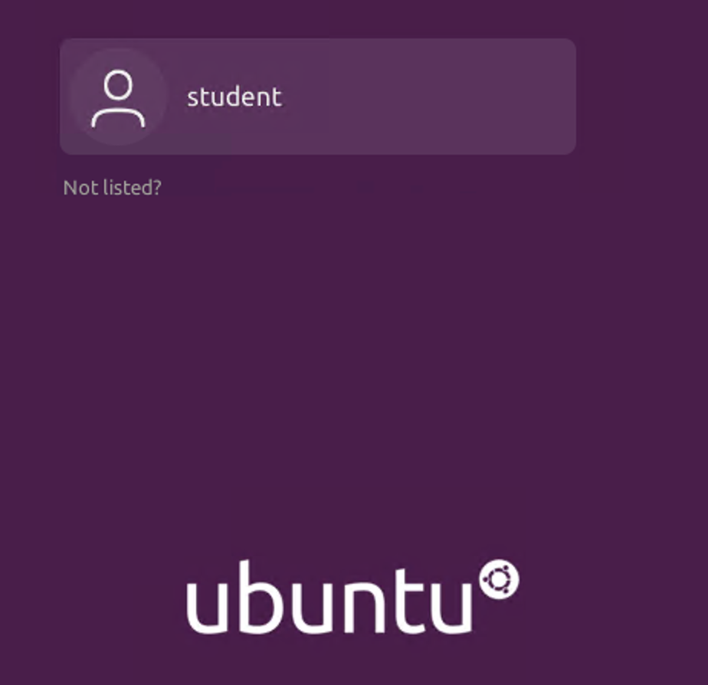
Remove users and groups

Slide 18
Network Configuration

Slide 19
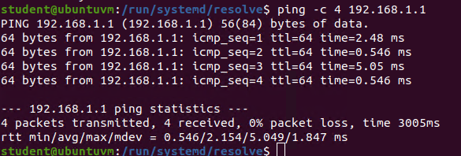
Discover host IP configurations
Take a screenshot of the output in Step 6.
1. What is the IP address of your Ubuntu machine?
192.168.1.104/24
2. What is the IP address of its default gateway?
192.168.1.1
3. What is the IP address of its DHCP server?
192.168.1.1
4. What is the IP address of its DNS server?
192.168.1.1

Slide 20
Manage network interfaces
1. Which DHCP message is shown in the output of the sudo dhclient –v –r eth0 command? [hint: the message name is in uppercase.]
2. Which four DHCP messages are shown in the output of the sudo dhclient –v eth0 command? [hint: the message names are in uppercase.]

Slide 21
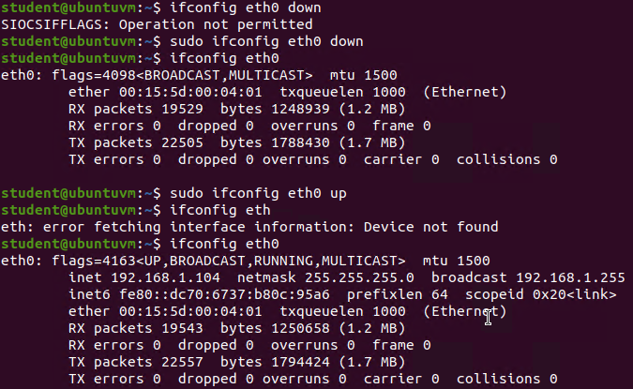
Use network utilities

Slide 22
System Performance Monitoring

Slide 23
Monitor Linux processes
1. What is the default action of the 15 SIGTERM kill signal?
Kill the highlighted process
2. In the System Monitor window, click on % CPU to sort the processes by CPU load. Which process shows the highest percentage of CPU usage?
gnome-shell

Slide 24
Monitor user activities
Issue the sudo accton on command to turn on GNC accounting. Run the sudo updatedb command. Enter lastcomm updatedb to check if the updatedb command was executed before. Remember to turn off GNC accounting (sudo accton off) after answering the questions.
1. What flag value is displayed in the output?
S -- means the command was executed by the root (superuser)
2. Why is the name of the user who ran the processes shown as root, not student?
“sudo” is put in front of the command, meaning Superuser Do which allowed the root user to execute the command.

Slide 25
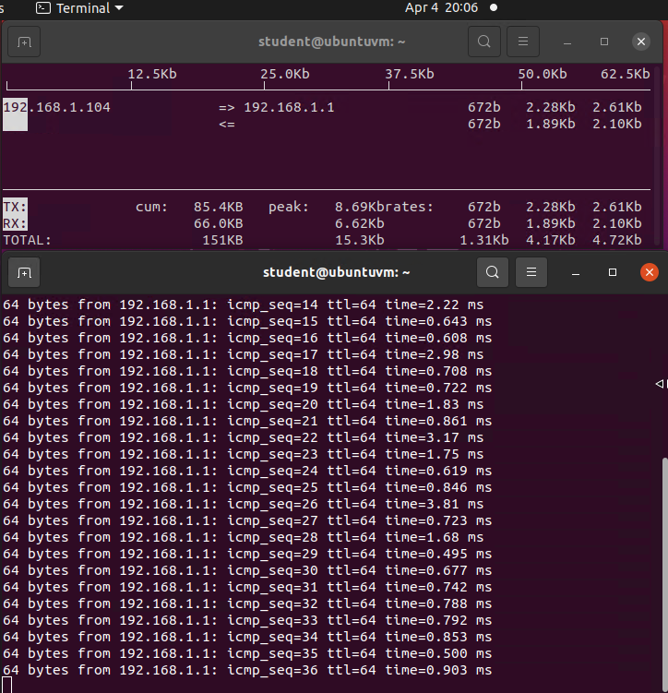
MONITOR NETWORK BANDWIDTH USAGE

Slide 26
What I Learned
Linux Operating System principles.
Security and performance fundamentals
Root user capabilities
Network monitoring

Slide 27
Conclusion
Linux is one of many types of operating systems suitable in a wide variety of business applications.
Linux’s free license concept gives developers the ability to focus on programming and networking, versus having to pay for licenses.
Linux is known to be more lightweight and faster as compared to implementing competitive and common operating systems.

