Slide 1
CEIS355A Business Application Programming
By: Vouthanack Sovann

Slide 2
Introduction
Build a Java Based Graphical User Interface with Calculation Functions
Generate Java updates and modifications to SQL connected databases
Utilize Java Netbeans and SQL to input coding and programming data
Create foundational Wireframe and UML Diagrams

Slide 3
Required Applications

Slide 4
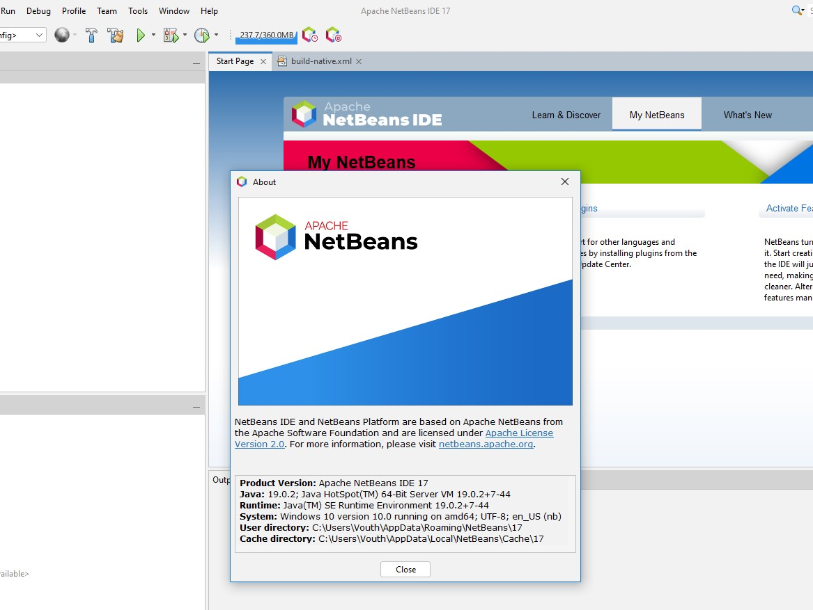
NETBEANS

Slide 5
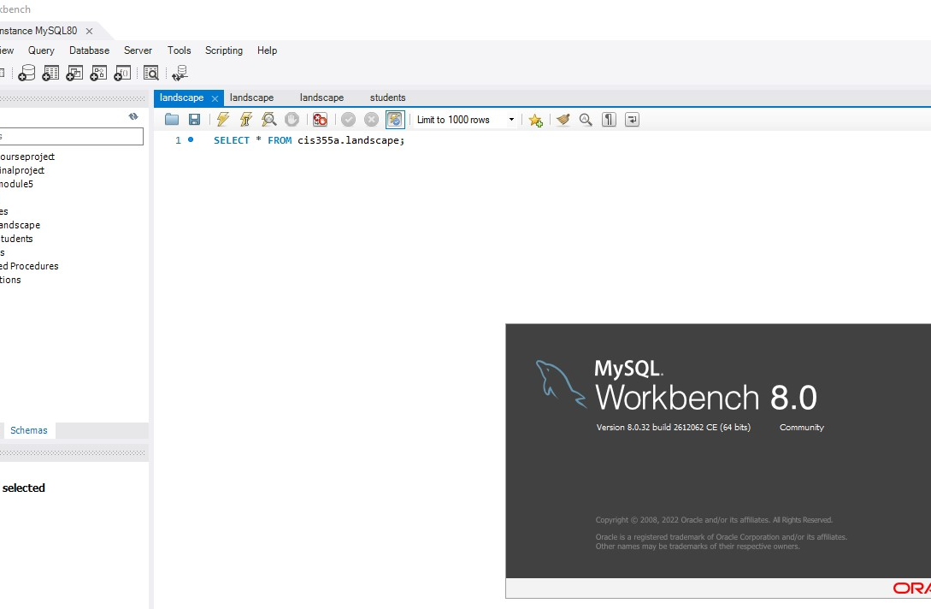
MySql Workbench

Slide 6
Diagrams in preparation for programming

Slide 7
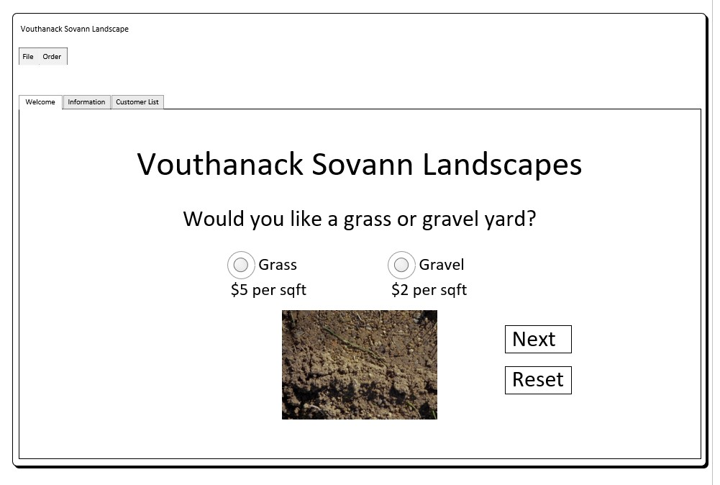
GUI Wireframe Diagram

Slide 8
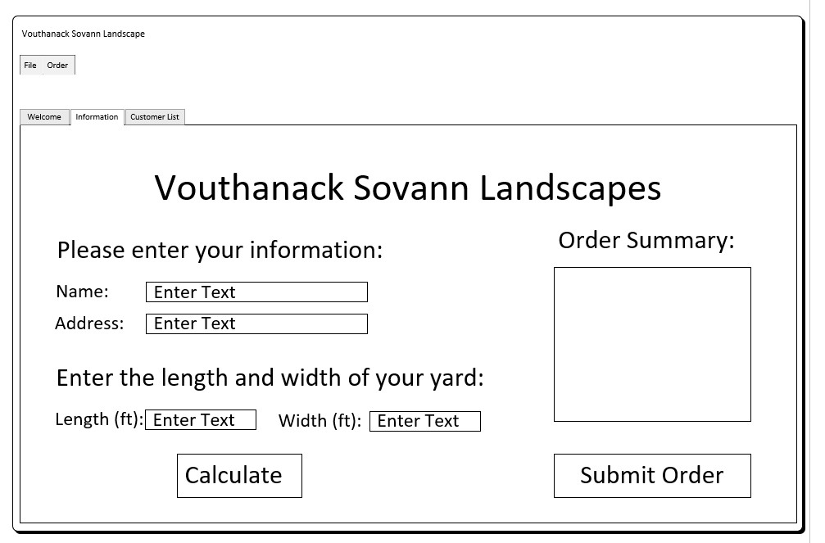
GUI Wireframe Diagram (cont.)

Slide 9
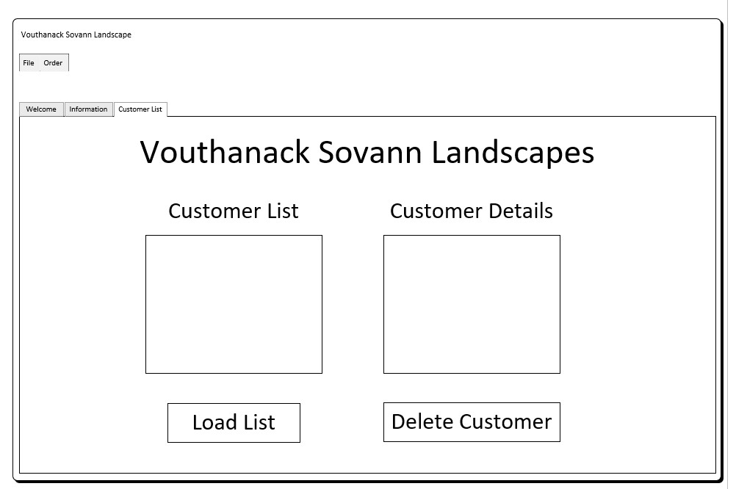
GUI Wireframe Diagram (Cont.)

Slide 10
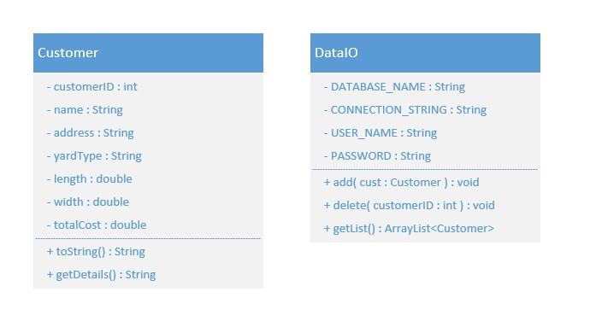
UML Class Diagram

Slide 11
Graphical user interface creation in netbeans

Slide 12
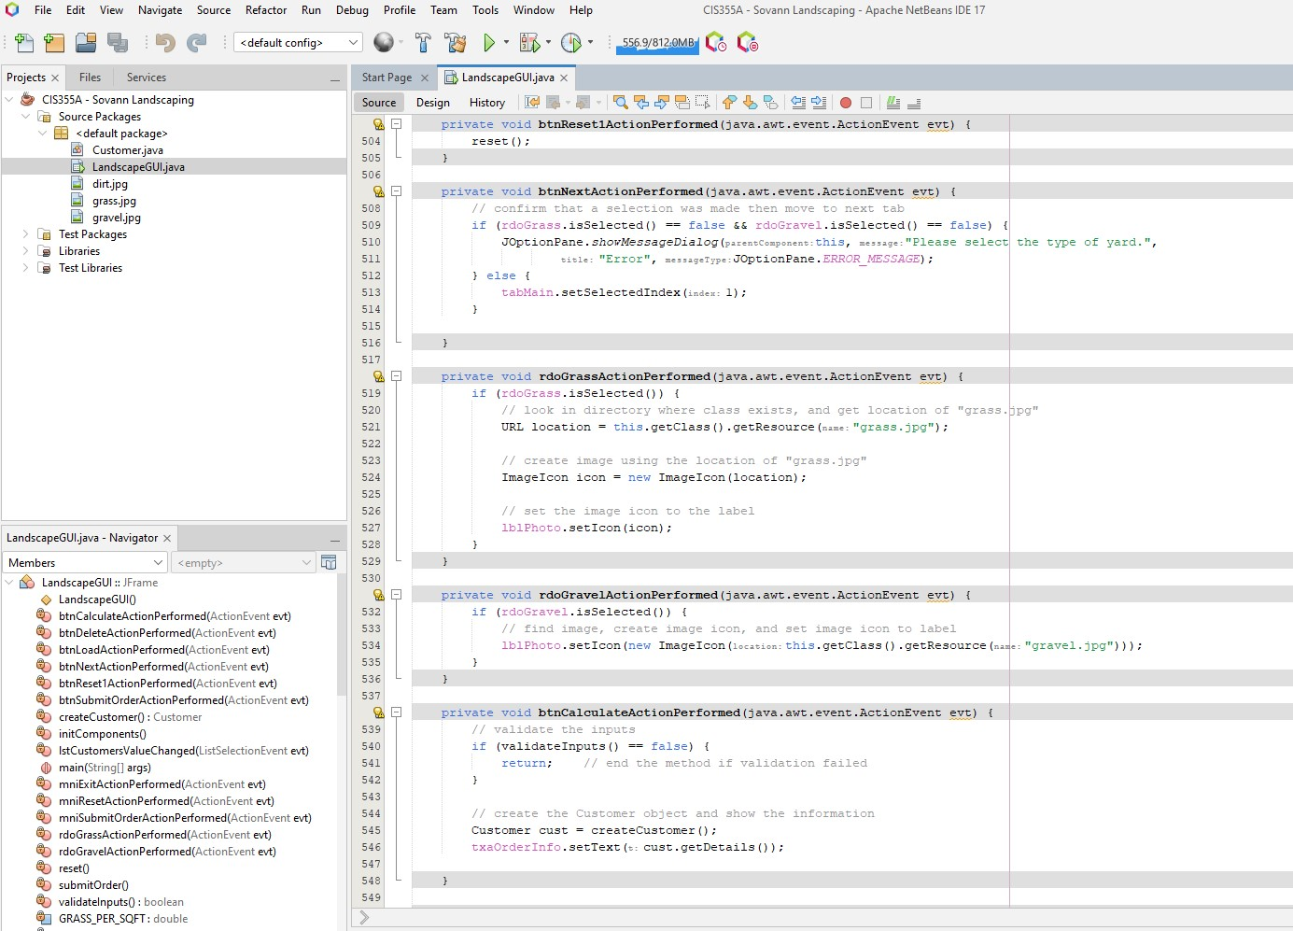
Creation of landscape gui source data

Slide 13
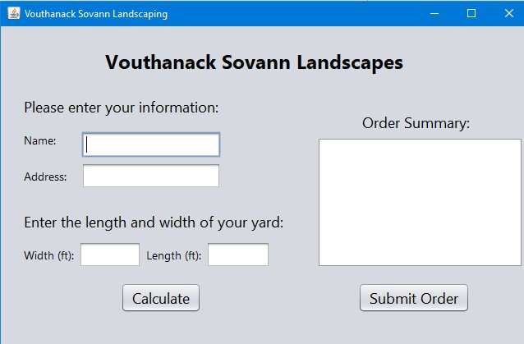
landscape gui preliminary design

Slide 14
Creating an advanced graphical user interface using netbeans

Slide 15
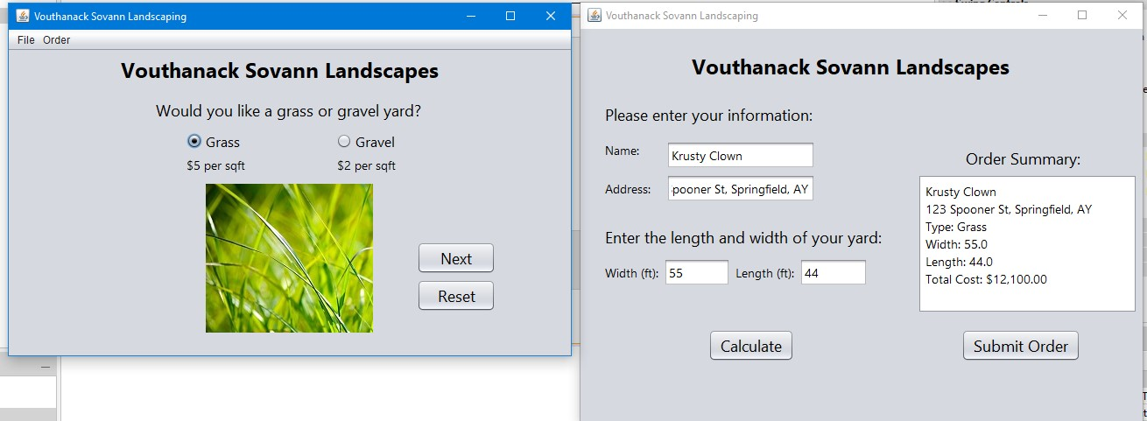
Advanced gui design with data entry calculations

Slide 16
Creating object arrays using netbeans

Slide 17
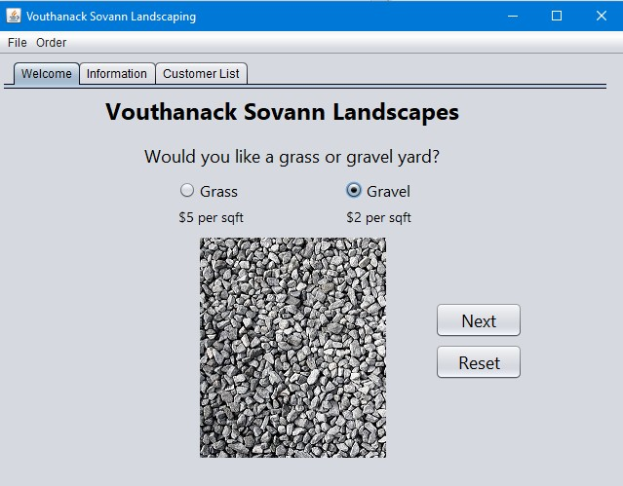
Welcome pane entry

Slide 18
Information pane entry – calculation and order submission

Slide 19
Customer list pane – load list button for customer details deletion button

Slide 20
Writing input data to a file using netbeans

Slide 21
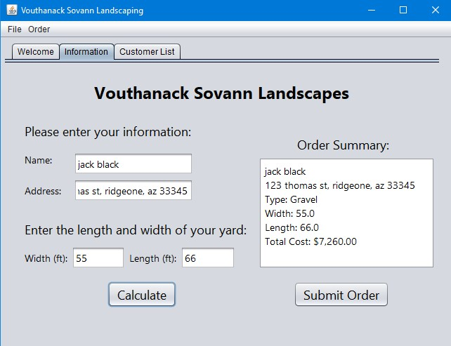
Data entry preparation to a file

Slide 22
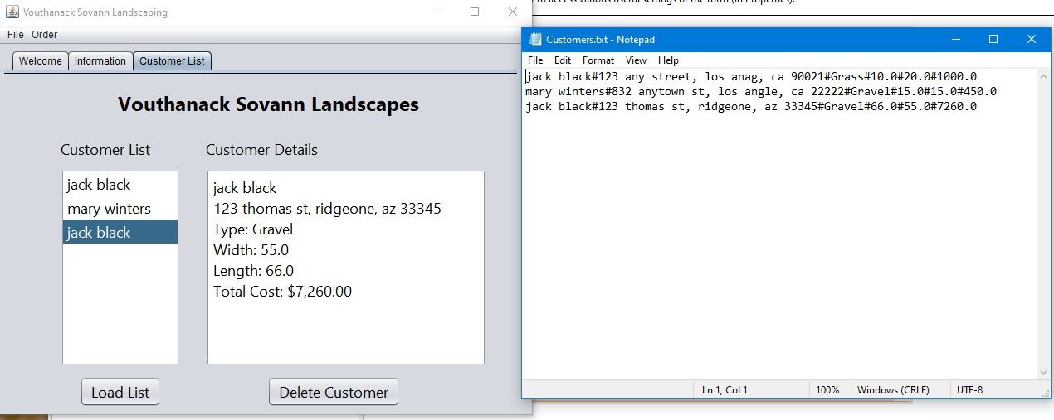
Data written to a file (customers.txt)

Slide 23
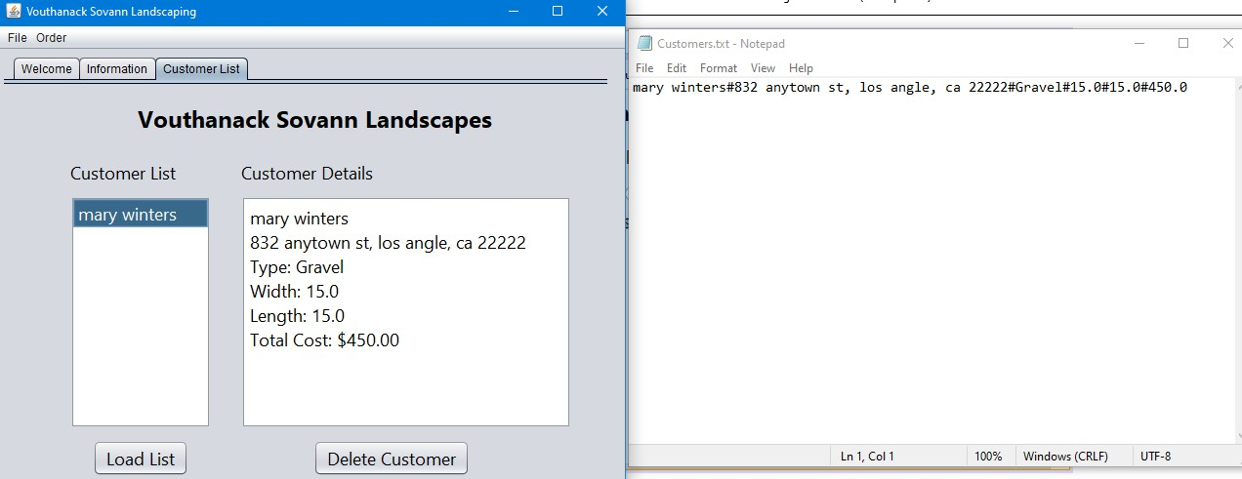
Data deletion from customers.txt

Slide 24
Writing and removing data from mysql workbench database

Slide 25
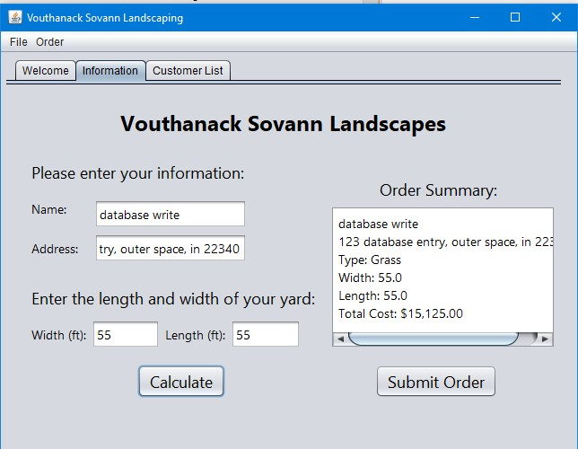
Customer data creation and submission

Slide 26
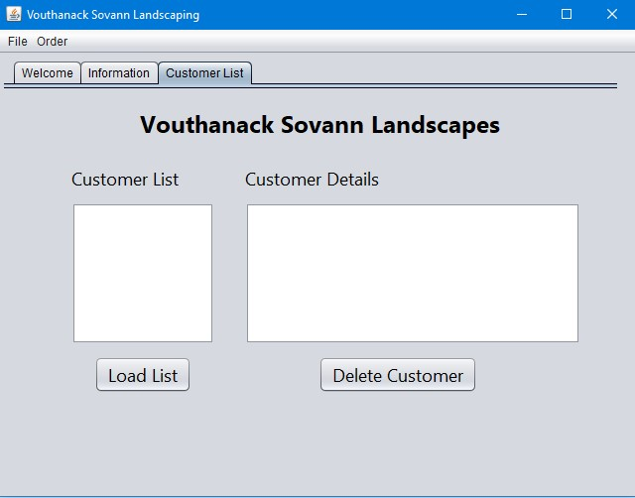
Initial view of empty customer list

Slide 27
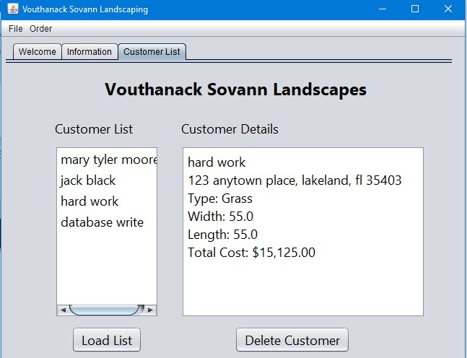
‘load list’ pulls current database entries

Slide 28
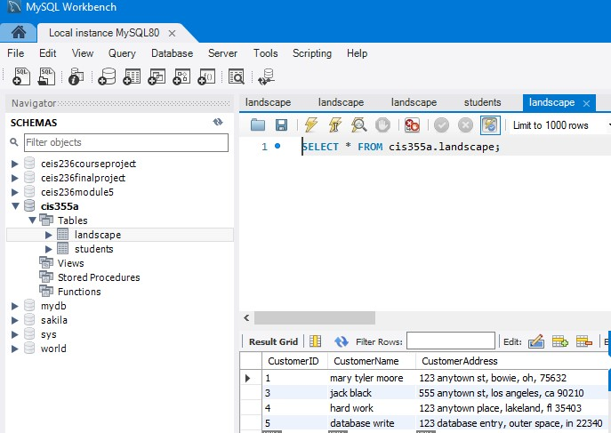
View of mysql database entries (confirmation)

Slide 29
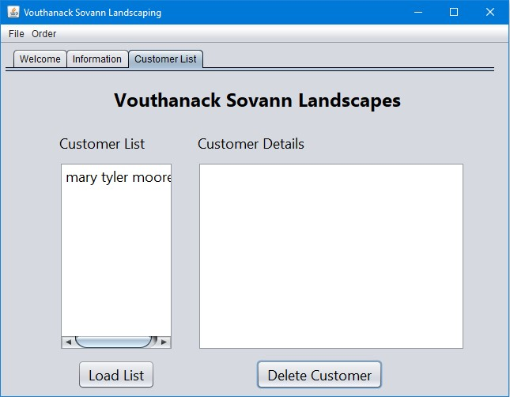
Deletion of 3 customers (with 1 customer remaining)

Slide 30
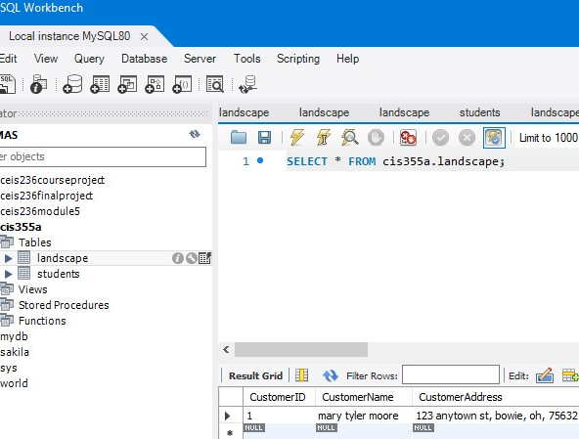
Confirmation of database table update with 1 customer remaining

Slide 31
Challenges
Attention to detail when coding every single line of entry is extremely important.
Single character errors when connecting Netbeans to MySQL will cause significant errors that will require line by line debug (and understanding of flows / processes)
Understanding of what and why are important to make the program work flawlessly.

Slide 32
Career skills
Software Knowledge
Networking/
Connectivity
Coding/
Programming
Operating System Fundamentals
Automation
Security

Slide 33
Conclusion
Coding can integrate many programs and applications to produce a functional product.
Java is robust and can be useful in many industries to support business functions.

