Slide 1
CEIS110 Programming with Data
Vouthanack Sovann

Slide 2
Introduction
Data is growing exponentially
This project uses cloud-based data to gather results on temperature and humidity
The data is analyzed using programming and data analytics.

Slide 3
Software Inventory
Before developing this programming, all required software was downloaded and installed.
The software included the following:
Excel
Python IDE - Anaconda

Slide 4
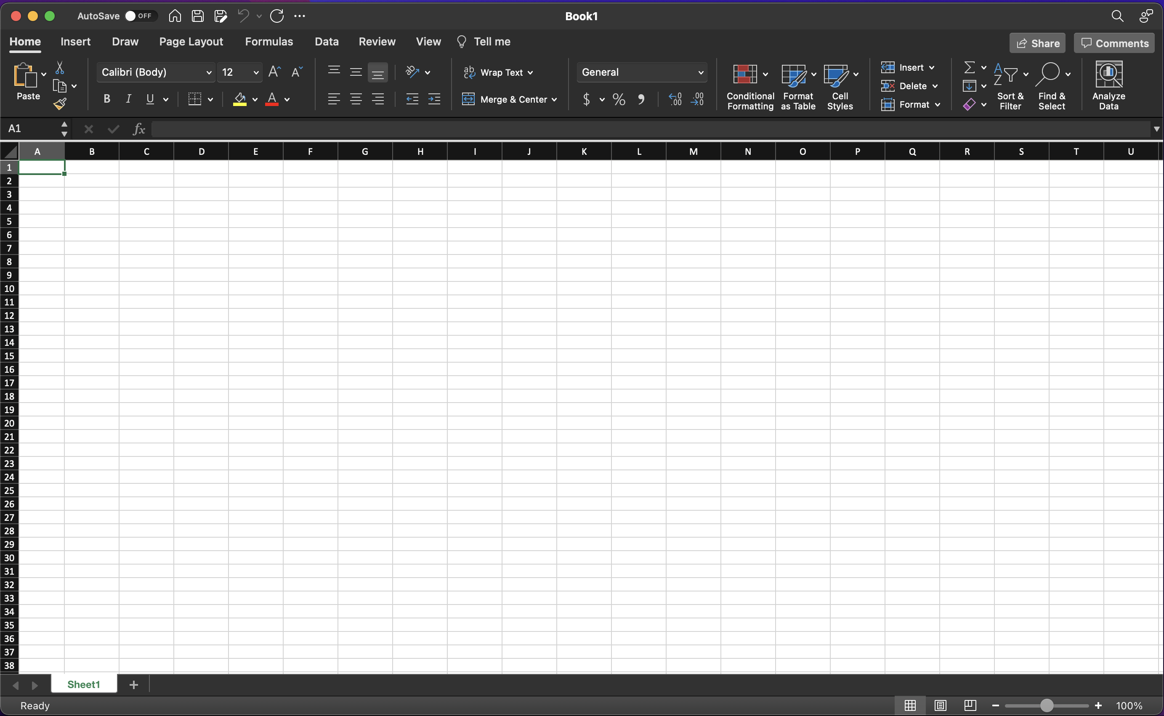
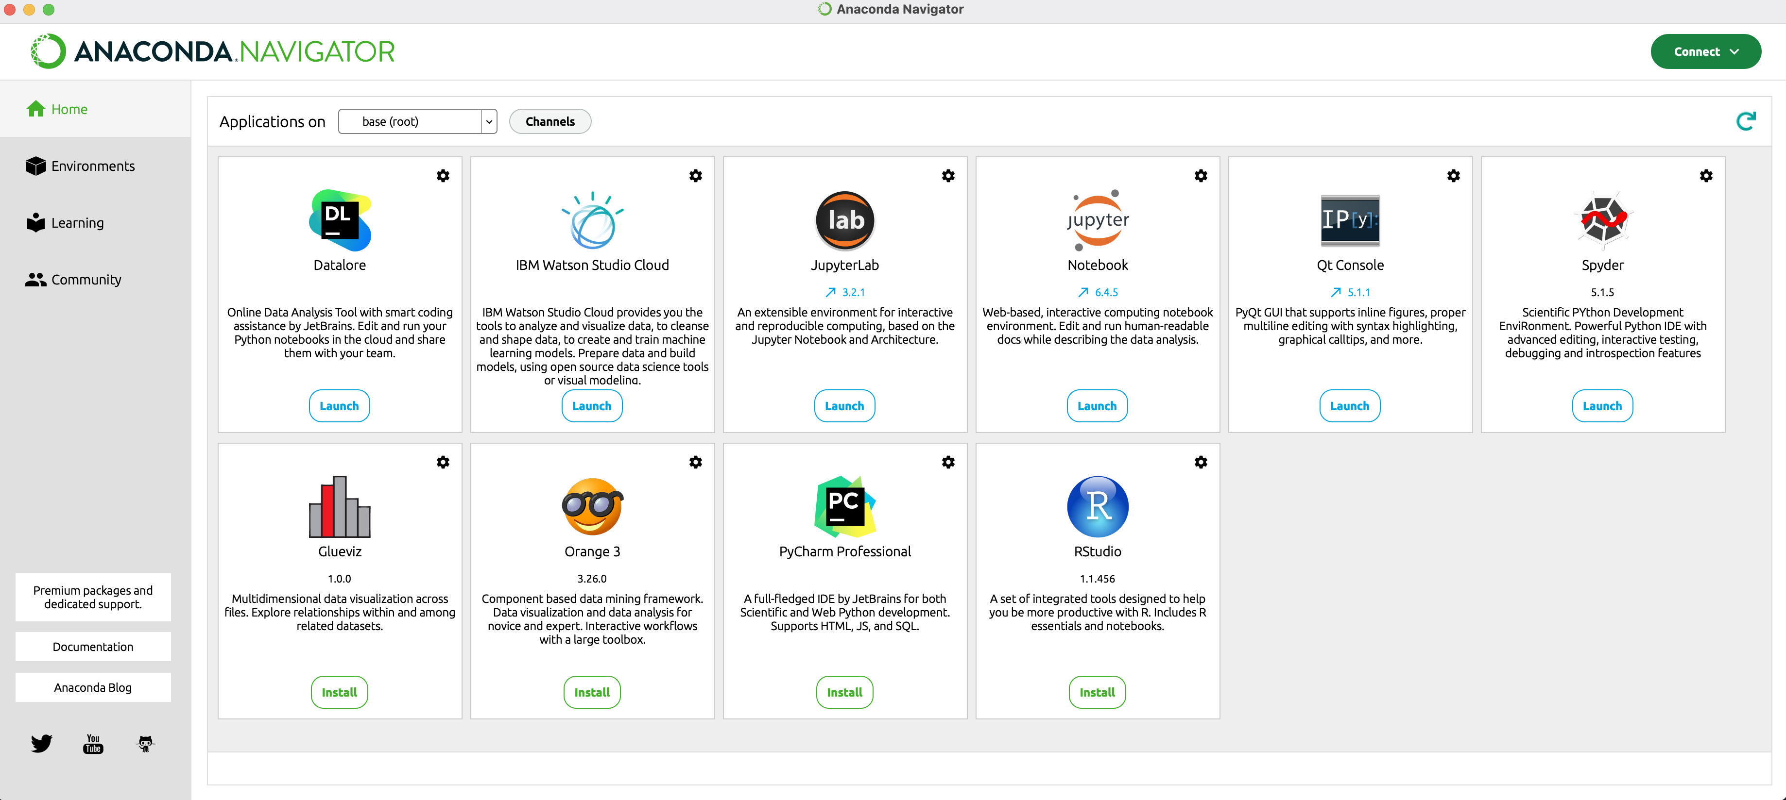
Software
Excel
Python IDE - Anaconda

Slide 5
Planning and Design
After performing an inventory of the software needed for the project, a plan was created for the temperature data project.
To plan the design of the project, a flowchart was generated
Planning and design of the project are crucial steps to understanding the development process

Slide 6
What are Flowcharts?
Flowcharts are graphical representations of processes or workflows, and the flowchart developed illustrates the process and the output of this software development project.
Many companies use flowcharts as simple narratives.

Slide 7
Flowchart
Install Python
Download weather data to a database
Extract weather data from database into a comma separated file with python
Stop
Cleanse weather data
Use python data analytics modules to develop graphical models
Use Excel to manipulate data
Start

Slide 8
Adding Library
In order for python to connect to the US Government National Oceanic and Atmospheric Administration (NOAA) weather data service using a cloud-based Application Programming Interface (API), a library module must be installed to use this service.
The screenshot shows the NOAA-SDK library installed.

Slide 9
Gathering Temperature and Humidity Data
After planning and design, the code was developed to download a set of weather observations.
This data was stored on a local database in a table for later analysis.

Slide 10
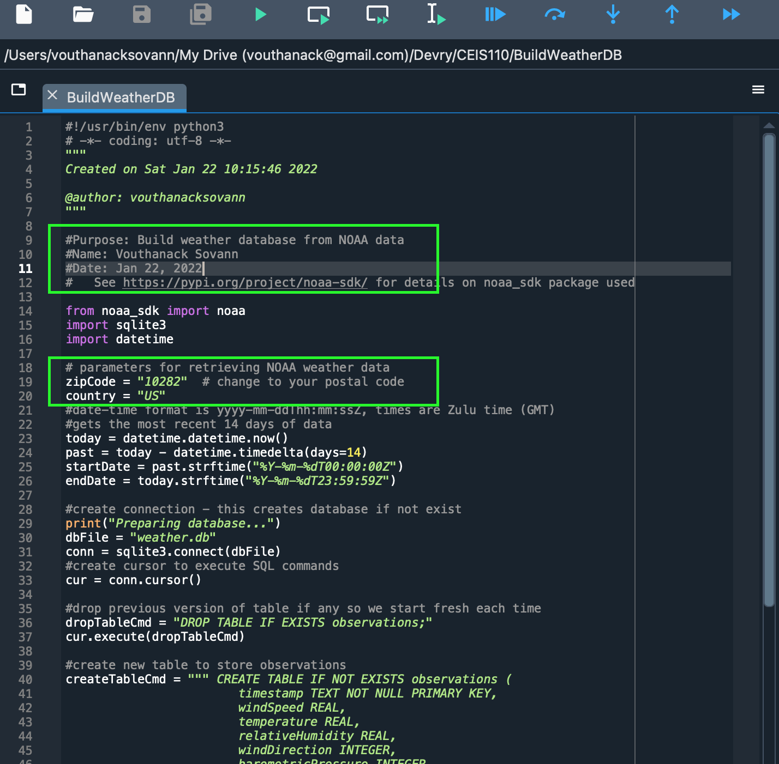
BuildWeatherDb.py Code
Screenshot of code in Spyder
The code will create a table named Observations with the fields: timestamp, windspeed, temperature, relativeHumidity, windDirection, barometricPressure, visibility, and textDescription.
The database will be named weather.db and stored in the same directory as the python code.

Slide 11
Weather.db File
Screenshot of Windows Explorer showing database file Weather.db was created

Slide 12
Querying the Database
Structured Query Language (SQL) is a programming language used for working with relational databases.
Sypder was used to query the database and view the results.

Slide 13
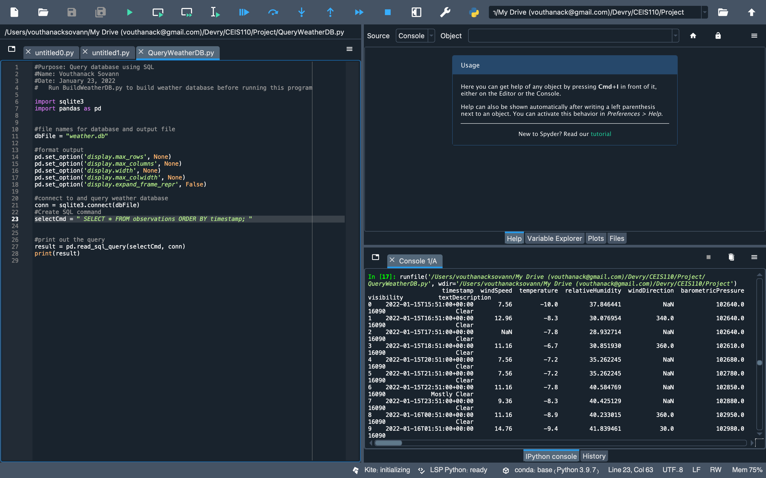
Query to retrieve all columns and all rows (Screenshot)
Screenshot of SQL query command and results

Slide 14
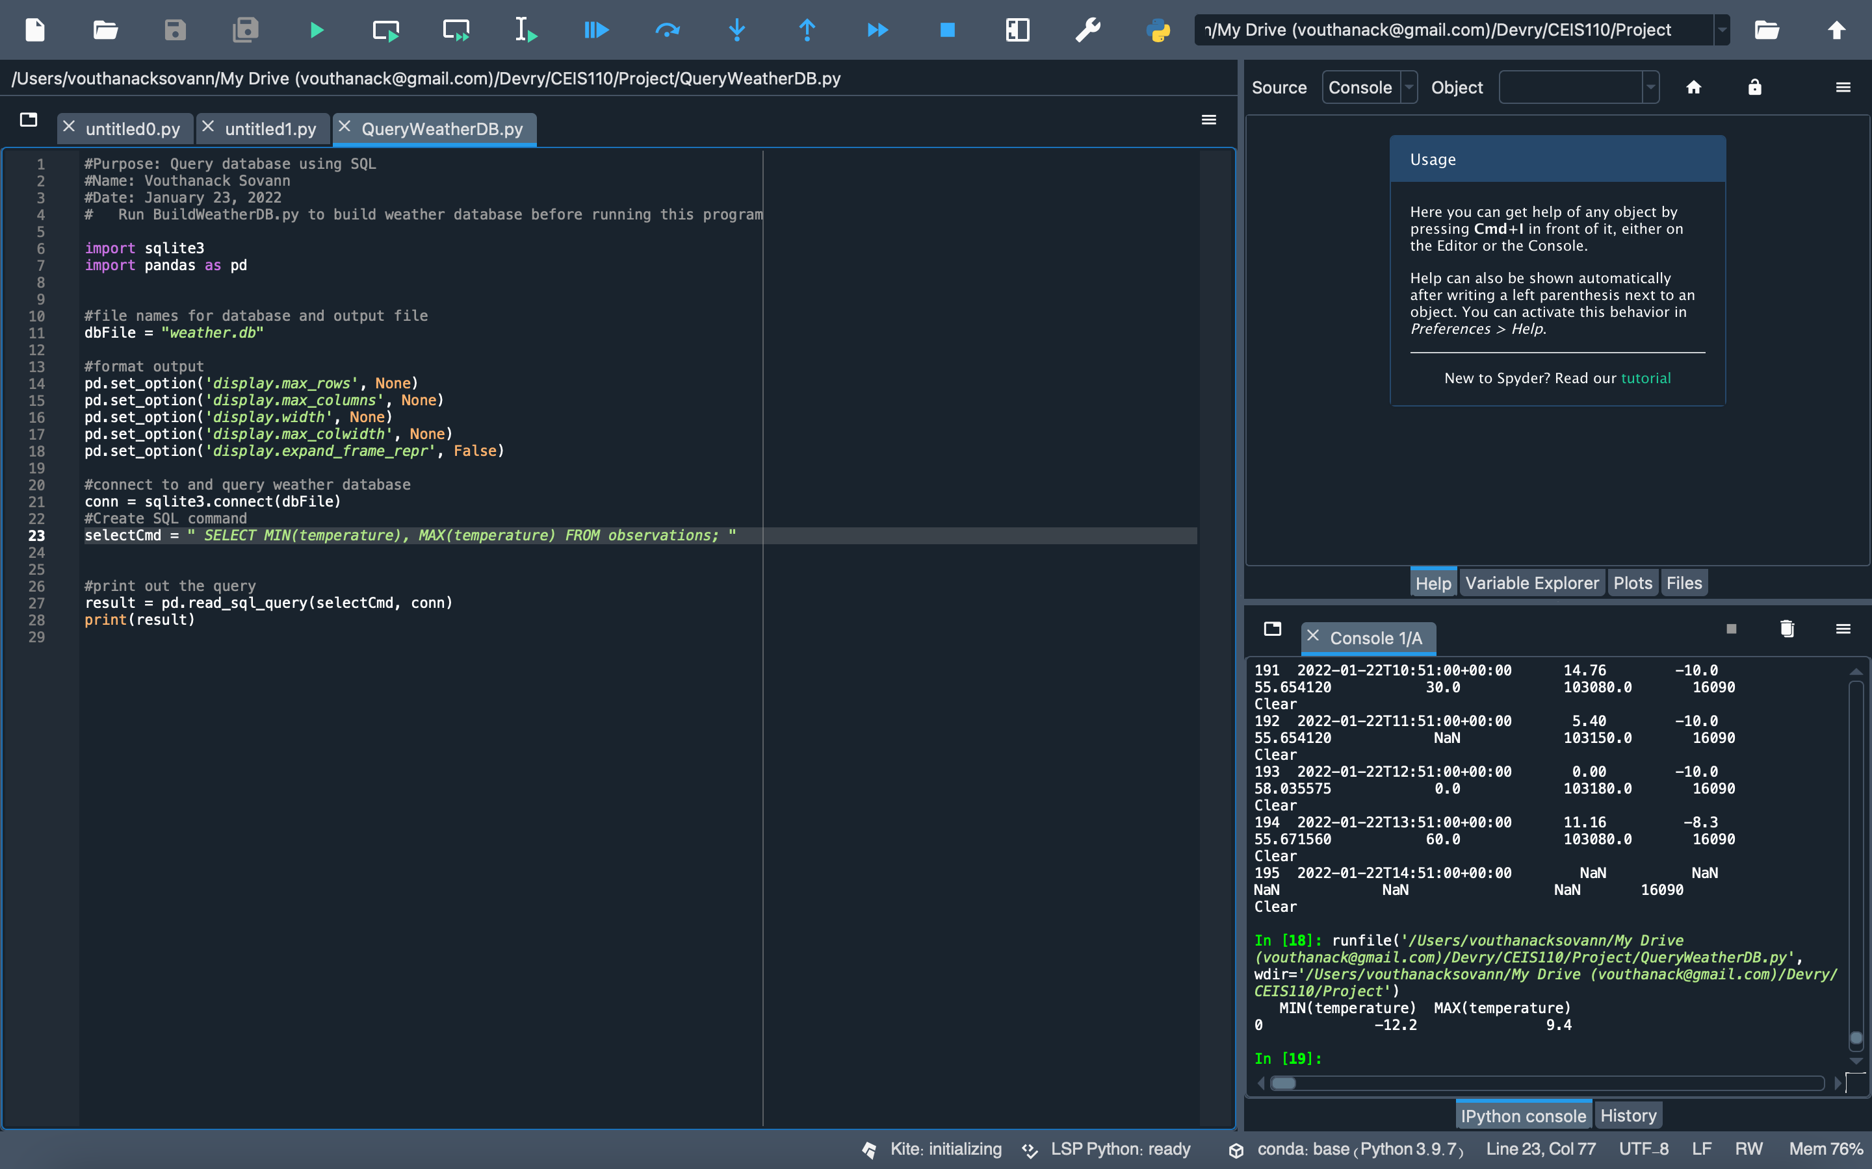
Query to retrieve lowest and highest temperatures (Screenshot)

Slide 15
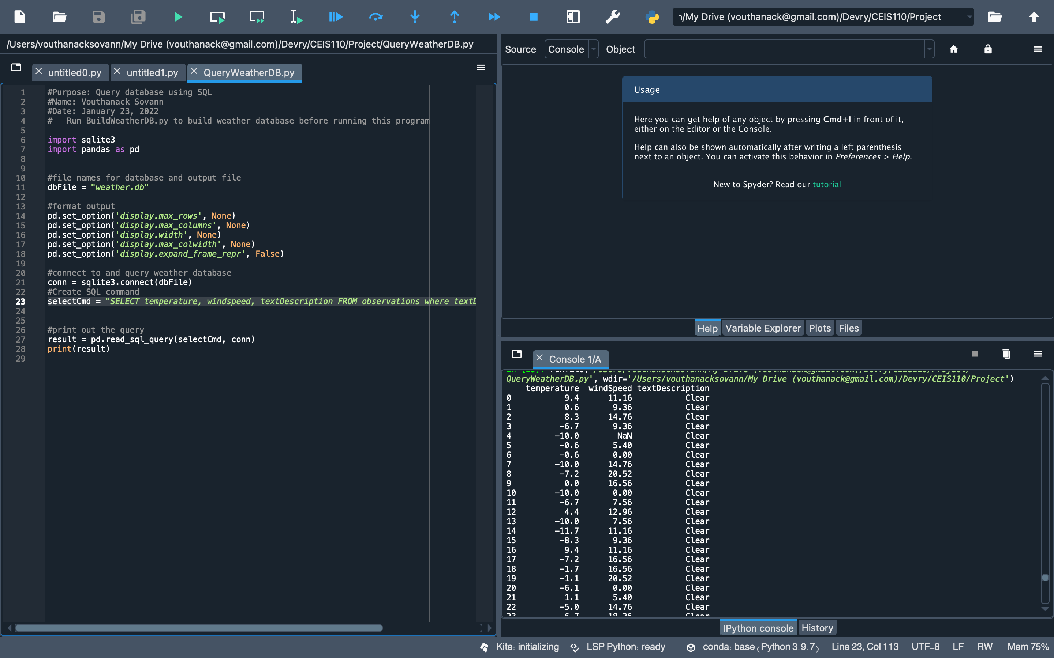
Query to retrieve all clear days (Screenshot)

Slide 16
Data Cleansing
Data output from machines may have errors or extraneous data. When cleansing the data, programs can automatically put it in the format needed to be read by other programs.
A python program is reading the data output by the python program and saving it in a csv file so that it can be read by Excel.
Often, data must be cleansed of spurious or missing values in a dataset. The data must be complete, valid, and standardized.

Slide 17
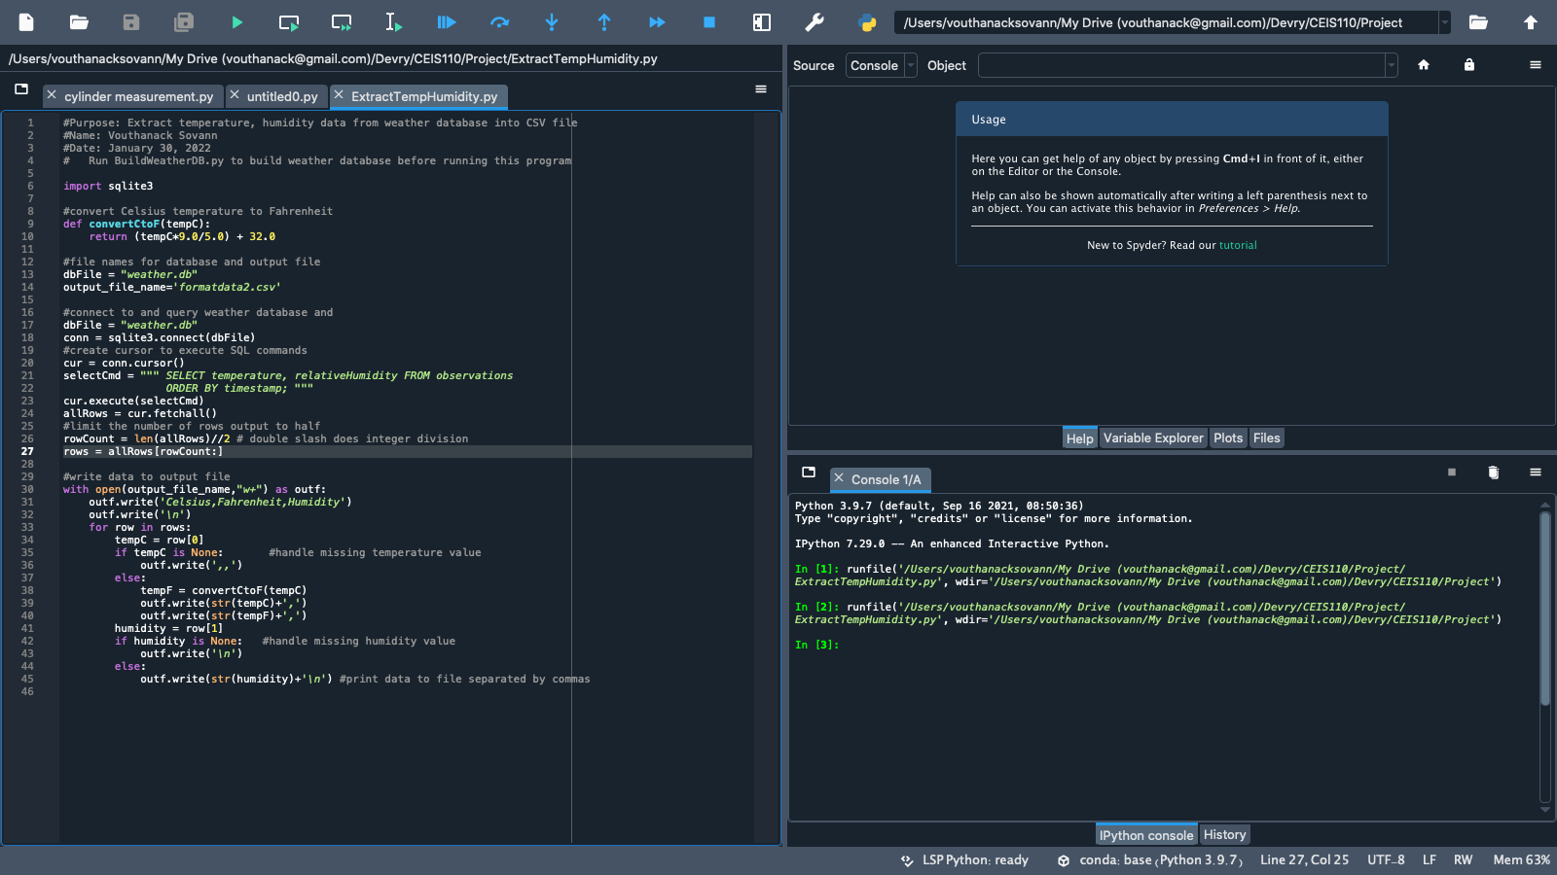
Python code (Screenshot or file)
ExtractTempHumidity.py Python code with your name and date in comments

Slide 18
Retrieve and Convert Data to CSV Format (Screenshot)
Formatdata file open in Excel showing 3 columns of data

Slide 19
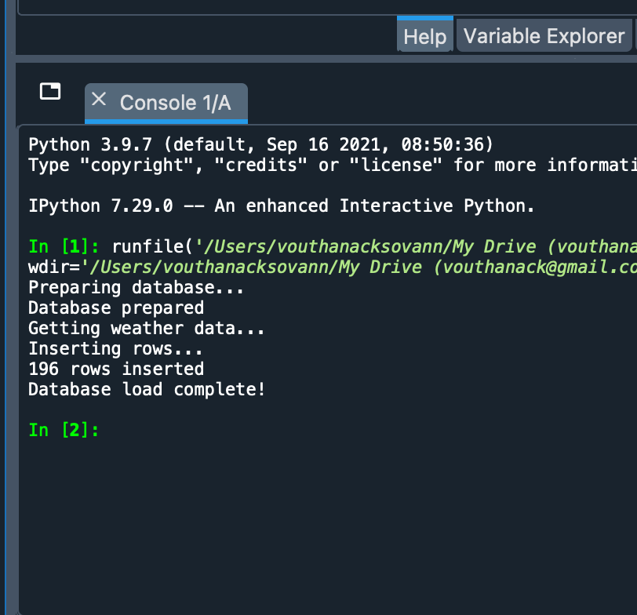
Python Console
Screenshot of program output in Python console showing program executed successfully

Slide 20
CEIS110 Module 4
Querying the database with SQL
By: Vouthanack Sovann

Slide 21
Rubric
Activity | Requirement(s) | Points
Query to retrieve all columns and rows | Screenshot of query and results | 20
Query to retrieve lowest and highest temperature | Screenshot of query and results | 20
Query to find all Clear days | Screenshot of query and results | 20

Slide 22
CEIS110 Module 5
Querying and manipulating data with SQL and Python
By: Vouthanack Sovann

Slide 23
Rubric
Activity | Requirement(s) | Points
Python code | Screenshot of code | 20
Retrieve and convert data into CSV format | Screenshot of data in Excel file | 20
Temperature and Humidity chart | Chart of data from database | 20

Slide 24
Temperature and Humidity Chart (Graph)
Excel chart based on temperature and humidity data from database

Slide 25
CEIS110 Module 6
Develop Graphical Models and Interpret Results
By: Vouthanack Sovann

Slide 26
Rubric
Activity | Requirement(s) | Points
Plot #1 | Picture/screenshot of plot from data with code | 15
Plot #2 | Picture/screenshot of plot from data with code | 15
Analysis | Question, plot, and answer | 15
Prediction | Prediction based on data | 15

Slide 27
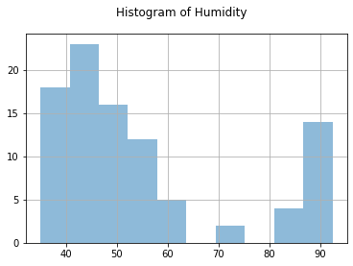
Plot #1
Plot and code used to generate it
Histogram

Slide 28
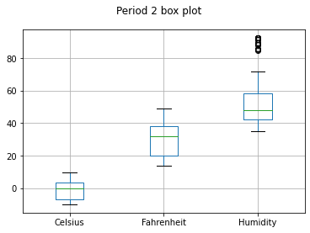
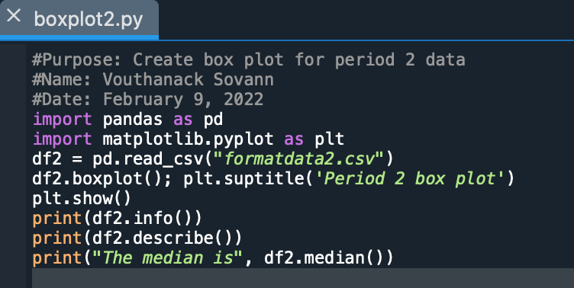
Plot #2 (Screenshots)
Plot and code used to generate it
Box

Slide 29
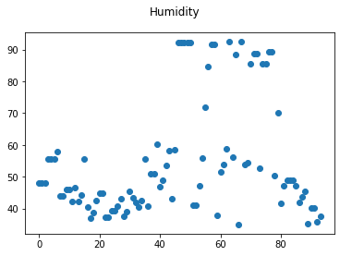
Analysis
Question / Answer:
Which temperature range will likely cause higher higher humidity?
Higher Temperatures will cause higher humidity. The scatterplot chart indicates higher humidity at higher temperatures

Slide 30
Prediction
Develop a prediction based on the data. What variations in temperature and humidity do you expect over the next few hours or days? How would humidity change if temperature goes up or down?
Based on the data, the humidity rises to peak levels after temperature exceeds 35F. Based on several charts documenting the trend of humidity between a range of 10F – 42F. Humidity is expected to reach peak levels for temperatures exceeding 35F. If we want to reduce the likelihood of maximum humidity, temperature should be less than 20F.

