Slide 1
NETW211 FUNDAMENTALS OF CLOUD COMPUTING
By: Vouthanack Sovann

Slide 2
Introduction
Fundamentals of Virtual Machines
Deploying an Azure VM, and Cleanup Process
Azure Vnet and Subnets
Azure VM Security, Storage and Monitoring

Slide 3
Virtual Machine (VM) Instances

Slide 4
Deploying a VM in Azure
This screenshot should show the NETW211VM page with information such as the resource group name, subscription, public IP address, etc.

Slide 5
Connecting to the VM
This screenshot should show the PROPERTIES for NETW211VM page, with the computer name, operating system version, hardware information, etc.

Slide 6
Deleting
the VM
This screenshot should show the Resource groups page, with the Azure for Students subscription selection and the “No resource groups to display” message.

Slide 7
Azure VNet and Subnets

Slide 8
Creating a VNet with Two Subnets
1. With a /24 network prefix, how many usable IPv4 host addresses are there? [hint: you learned this in NETW191]
Answer here: 251
2. Given the answer above, why is the number of available IP addresses for Subnet0 (10.0.0.0/24) or Subnet1 (10.0.1.0/24) shown as 251? [hint: where did the missing addresses go?]
Answer here: Azure VNet reserves three addresses.
VNET: 192.168.0.0/24 Network Address: 192.168.0.0 Reserved Address: 192.168.0.1-192.168.0.3 Broadcast Address: 192.168.0.255
References:
1. IP Subnet Calculator, https://www.calculator.net/ip-subnet-calculator.html
2. Azure Virtual Network frequently asked questions, https://docs.microsoft.com/en-us/azure/virtual-network/virtual-networks-faq
3. NETW211 CP Guide Module 3
4. Why Subnet 24 has 251 available addresses, https://social.msdn.microsoft.com/Forums/en-US/14454057-f519-4ff5-ad50-5b40a036ce74/why-azure-vnet-available-space-only-251-address-in-24-network?forum=WAVirtualMachinesVirtualNetwork

Slide 9
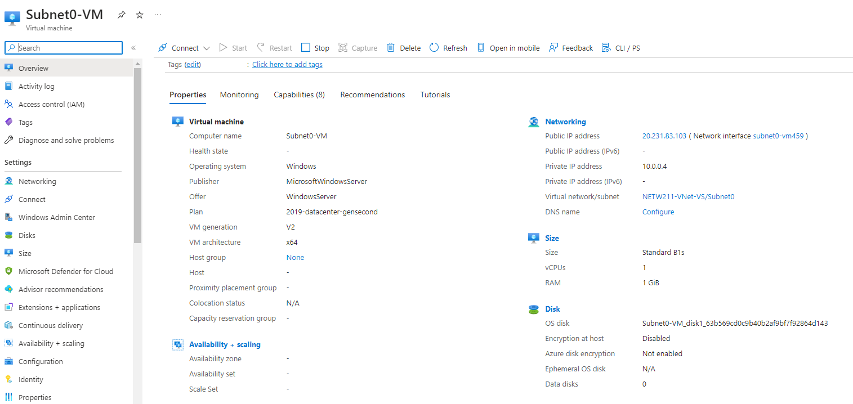
Deploying VMs into Subnets
This screenshot should show the Properties section of the Subnet0-VM page, showing the networking and size information of the VM.

Slide 10
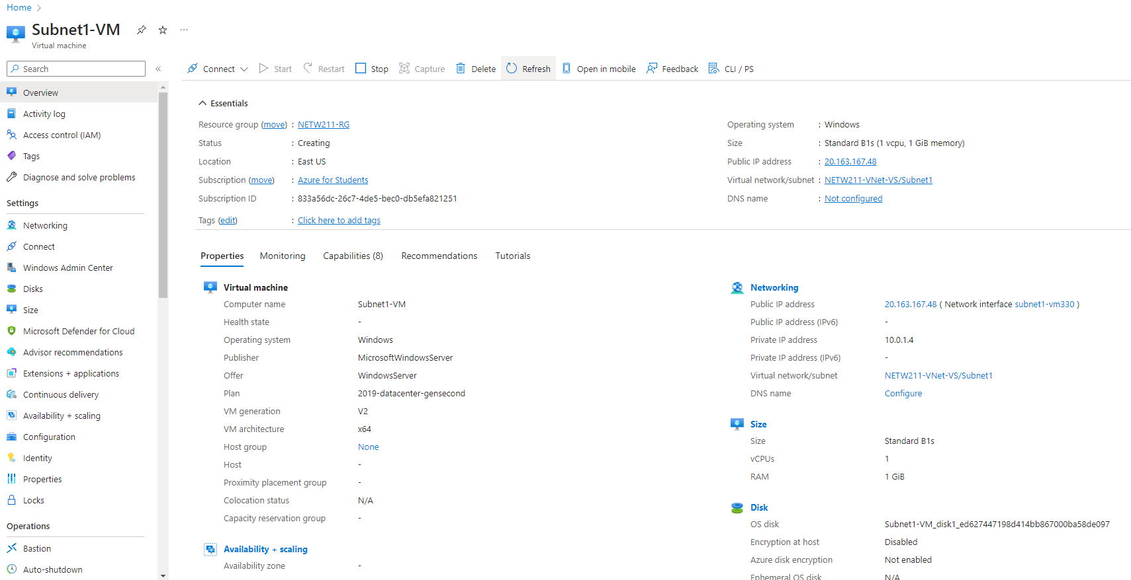
Deploying VMs into Subnets cont’d
This screenshot should show the Properties section of the Subnet1-VM page, showing the networking and size information of the VM.

Slide 11
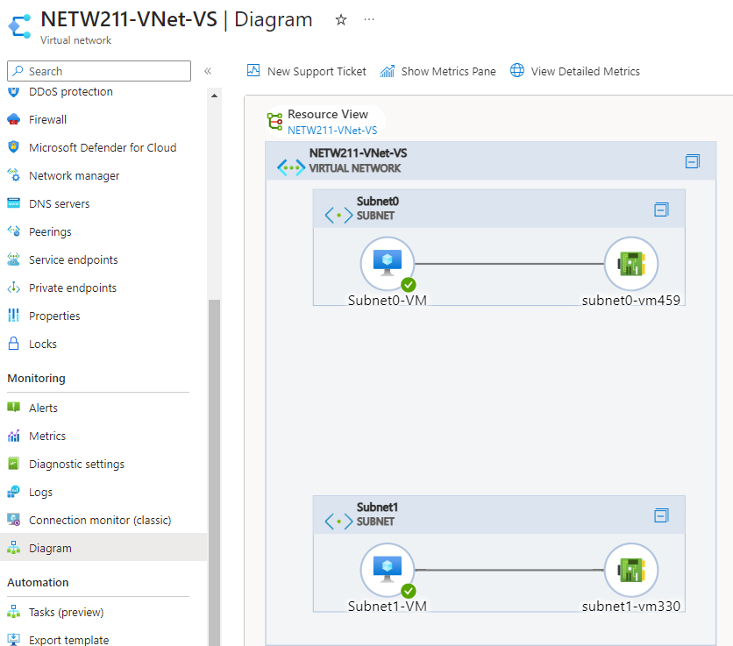
Deploying VMs into Subnets cont’d
This screenshot should show the topology diagram of your VNet (NETW211-VNet-Your Initials) with two subnets (Subnet0 and Subnet1) and one VM in each subnet (Subnet0-VM and Subnet1-VM).

Slide 12
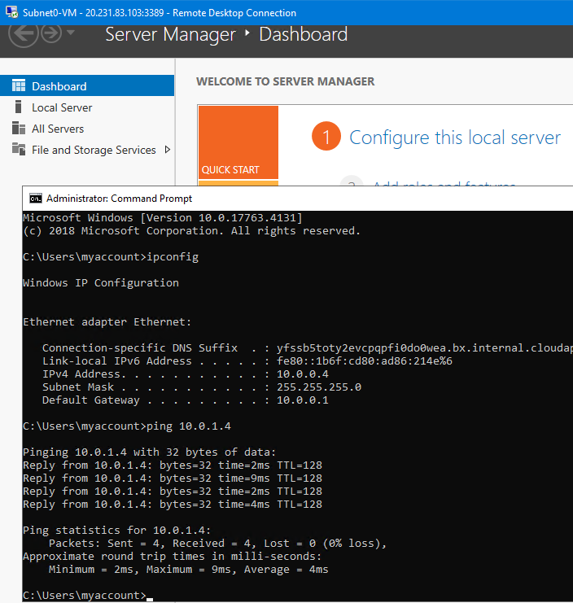
Verifying Connectivity between VMs
This screenshot should show the ipconfig and ping x.x.x.x results in the command prompt window, including the Subnet0-VM – x.x.x.x – Romote Desktop Connection window title.

Slide 13
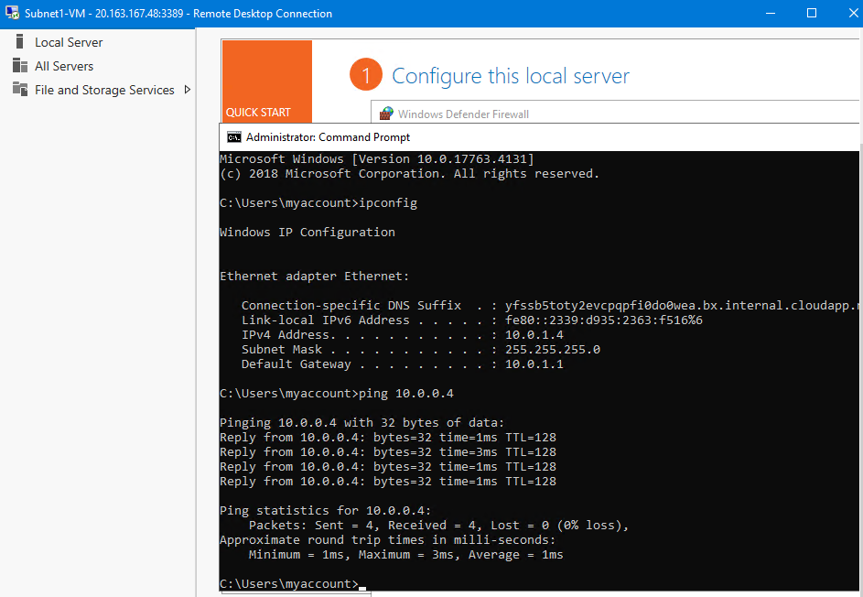
Verifying Connectivity between VMs
cont’d
This screenshot should show the ipconfig and ping x.x.x.x results in the command prompt window, including the Subnet1-VM – x.x.x.x – Romote Desktop Connection window title.

Slide 14
Azure VM Security

Slide 15
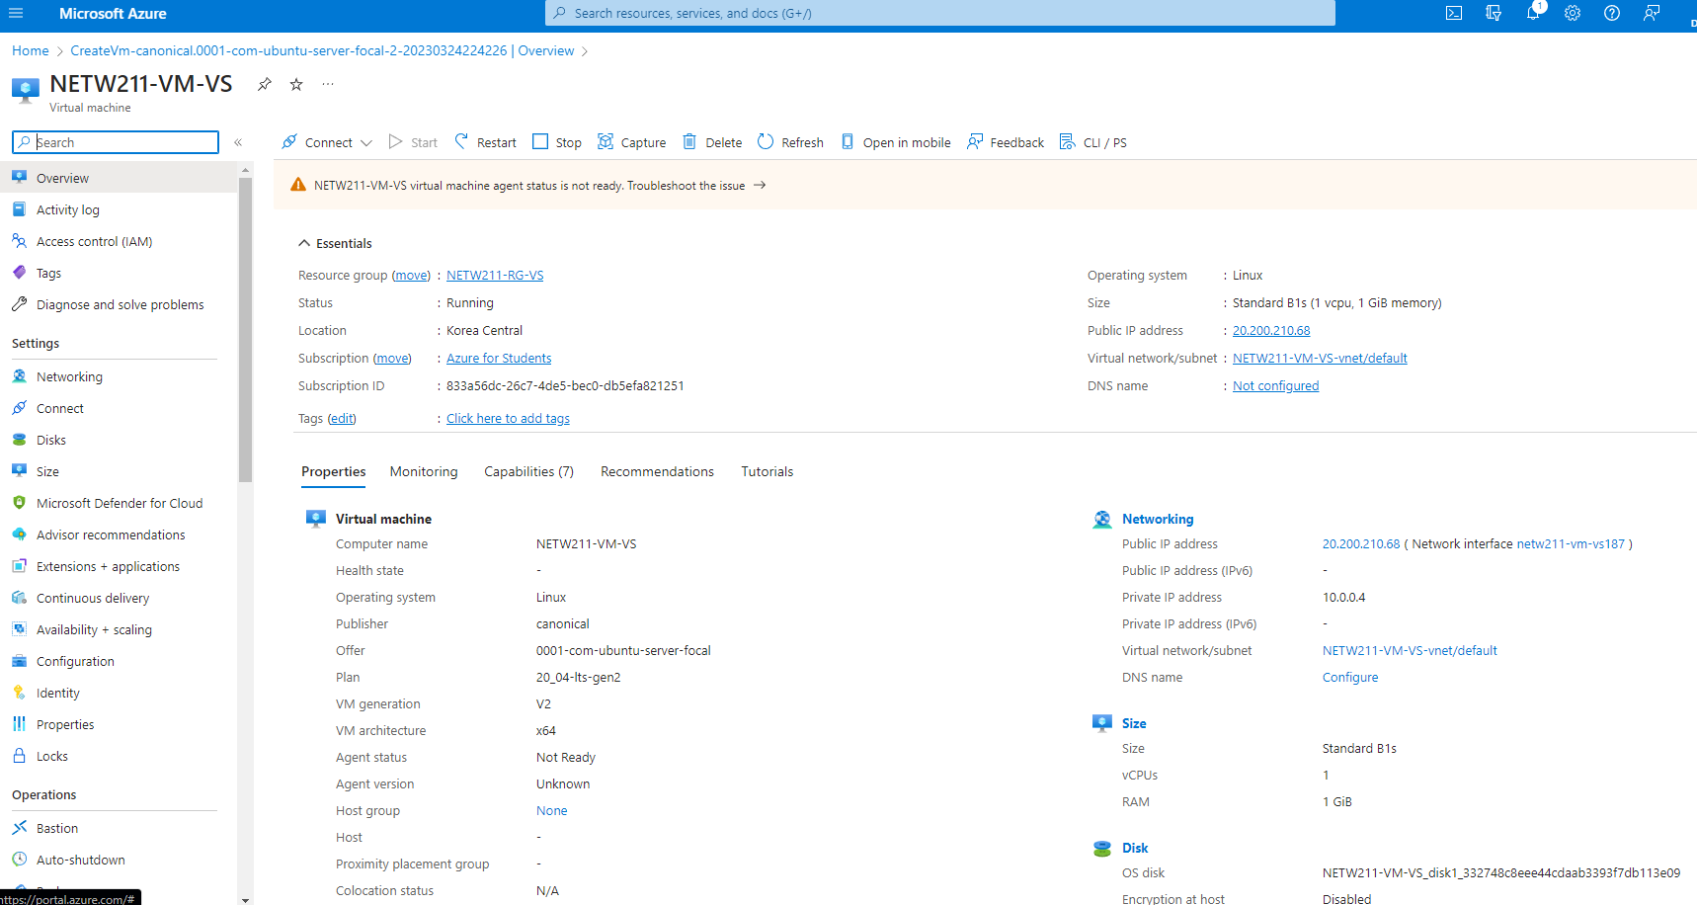
Launching a VM
This screenshot should show the NETW211-VM-Your Initials page, with information such as the resource group name, subscription, public IP address, etc.

Slide 16
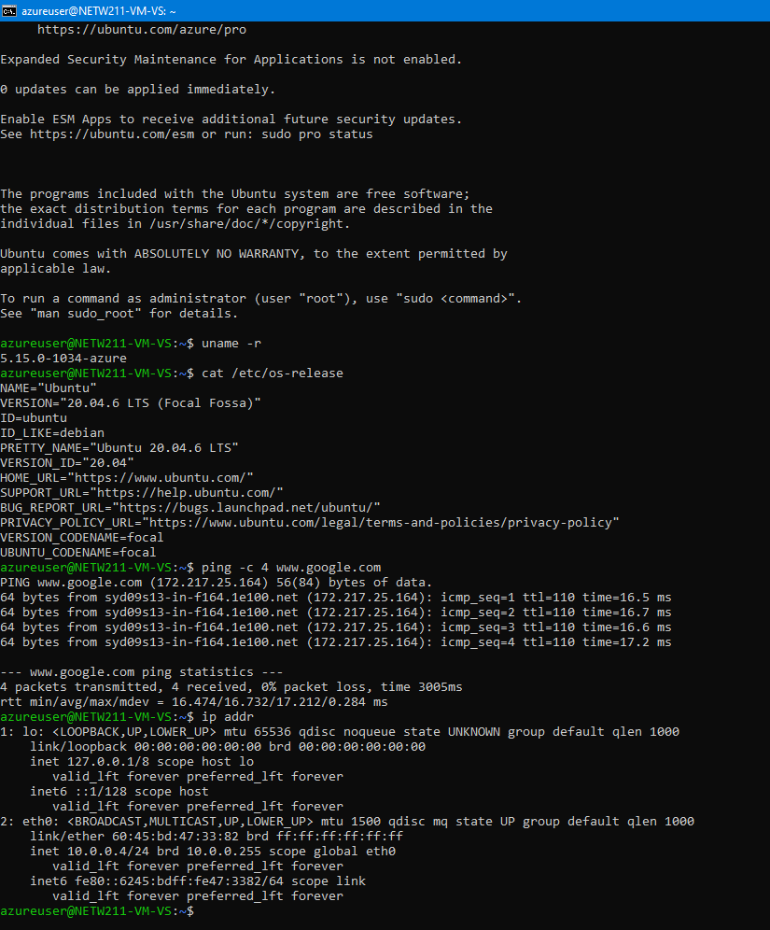
Connecting to the VM via SSH
This screenshot should show the azureuser@NETW211-VM-Your Initials window showing the IPv4 address of the VM in the Azure cloud.

Slide 17
Configuring an NSG
This screenshot should show the Inbound port rules section with the newly added Allow_Ping rule.

Slide 18
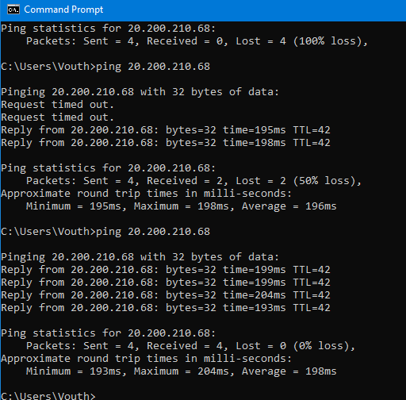
Configuring an NSG cont’d
This screenshot should show the successful ping result from your local computer to the VM in the Azure cloud.

Slide 19
Cloud Storage

Slide 20
This screenshot should show the browser window with the image uploaded from your local computer and the URL on top of the window.
Uploading and Accessing a File

Slide 21
Question
What does the access tier setting do? What are the Azure blob storage access tiers?
The access tier setting changes the data optimization settings based on frequency of use patterns, with Hot tier being the most costly and frequently used storage option, then Cool tier being data that is not normally used within a 30 day timeframe, then an Archive tier that does not get access before 180 days, which is the most cost-effective storage option.
Changing the tier options will help save a user or entity money when it comes to storing data.
References (here are two examples to get your research started):
1. Hot, Cool, and Archive access tiers for blob data, https://docs.microsoft.com/en-us/azure/storage/blobs/access-tiers-overview
2. Azure Blob Storage Access Tiers, https://devry.percipio.com/courses/c7ef0333-8560-403f-a004-9c5c843866b0/videos/2658bbe6-ee97-438b-a376-fbb079c3b3a0
3. Hot, cool, and archive access tiers for blob data, https://learn.microsoft.com/en-us/azure/storage/blobs/access-tiers-overview

Slide 22
This screenshot should show the browser window with the “This is the original version. –Your Initials” message and the URL on top of the window
Creating Blob Snapshots

Slide 23
This screenshot should show the browser window with the “This is the first revised version. –Your Initials” message and the URL on top of the window.
Enabling Blob Versioning

Slide 24
Cloud Monitoring

Slide 25
Setting up an Action Group and Notifications
This screenshot should show the “VM-Status-Change” action group on the Manage actions page.

Slide 26
Setting up Alert Rules
This screenshot should show the Alert rules window showing the VM-Deallocate and VM-Restart rules.

Slide 27
Testing Alerts
This screenshot should show the ‘VM-Restart’ was activated email message with the date and time of the alert.

Slide 28
Testing Alerts cont’d
This screenshot should show the ‘VM-Deallocate’ was activated email message with the date and time of the alert.

Slide 29
What I Learned
Fundamentals of VM Deployments in Azure
Hardening Azure VMs
Creating Storage Volumes as Required
Flexibility of Azure Cloud for Business and Projects

Slide 30
Career skills
Hardware /
Device Knowledge
Networking/
Connectivity
Operating System Fundamentals
Automation
Security

Slide 31
Challenges
Understanding Azure Centric Terminology
Limitations on Student Subscription Account
Cost Prohibitive Actions due to Variety of Azure Services
Reminder to Remove Resource Groups after Completing projects to prevent recurring costs.

Slide 32
Conclusion
Each Cloud Service (ex. Azure / AWS / Google) provide a variety of Cloud solutions for customers.
It is easy to deploy an Azure VM and provision remote access.
The benefit to using cloud services versus traditional on-prem is evident through significant cost savings!

