Slide 1
CEIS 150 Python Stock Tracking Project
By: Vouthanack Sovann

Slide 2
Introduction
Programming a stock list compiler from start to finish.
Usage of Anaconda / Spyder to input code entry.
Testing and stock report generation
Information gathering from historical data charts on popular websites.
Data ingestion into the program.
Reports and stock market volume trading data generated on a chronological graph.

Slide 3
Software Environment Setup
Objective:
Ensure Python Program is Running Successfully

Slide 4
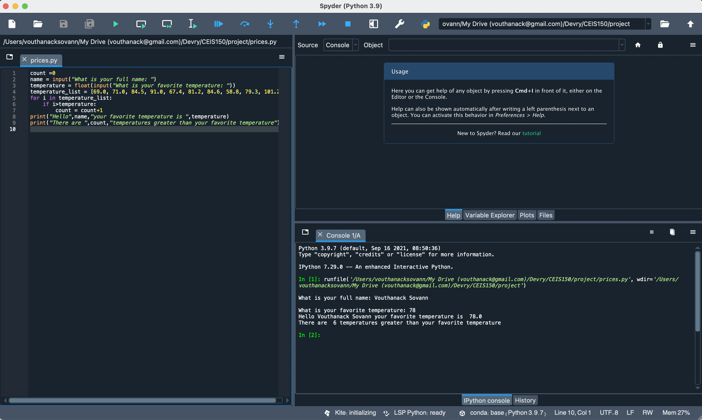
Program

Slide 5
Class Diagrams
Class Coding
Unit Testing
Objectives:
Class Diagram
Class Code
Unit Test

Slide 6
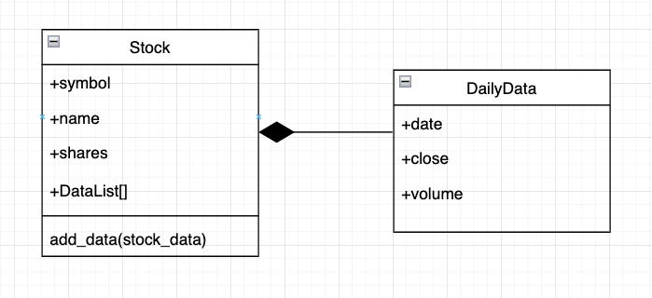
Class Diagram

Slide 7
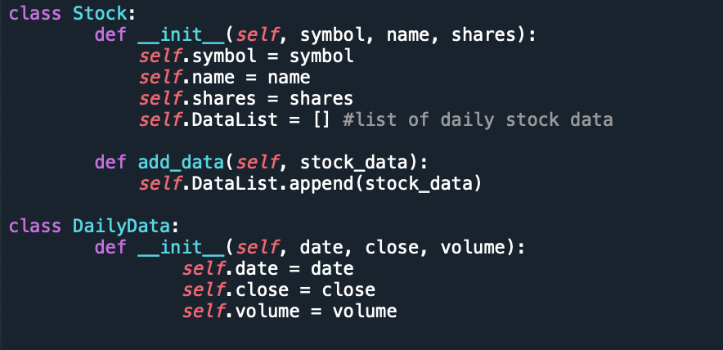
Class Code

Slide 8
Unit Test

Slide 9
Text-Based User Interface
Summary Report
Objectives:
Adding a Stock
Listing all Stocks
Daily data

Slide 10
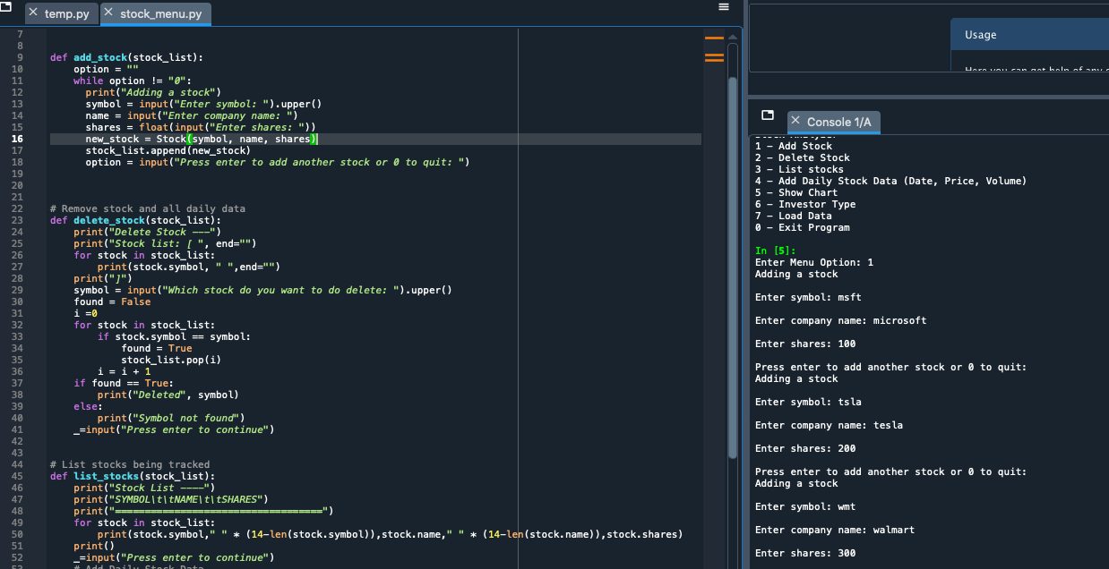
Adding a Stock

Slide 11
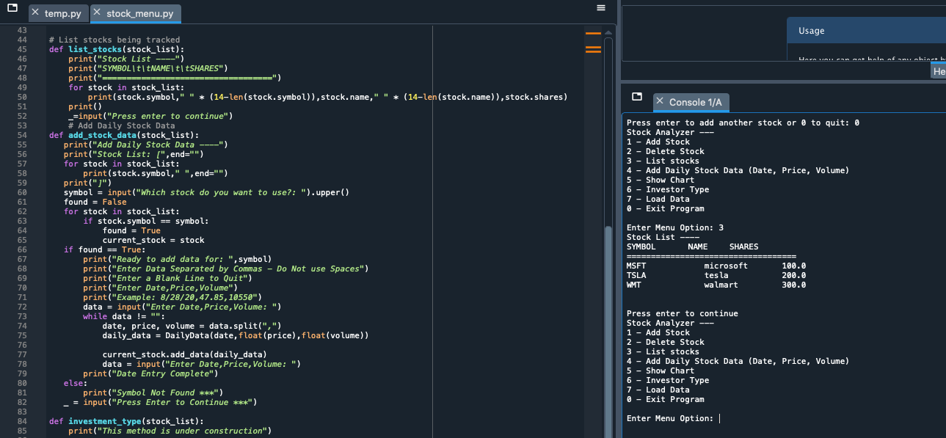
Listing 3 Stocks

Slide 12
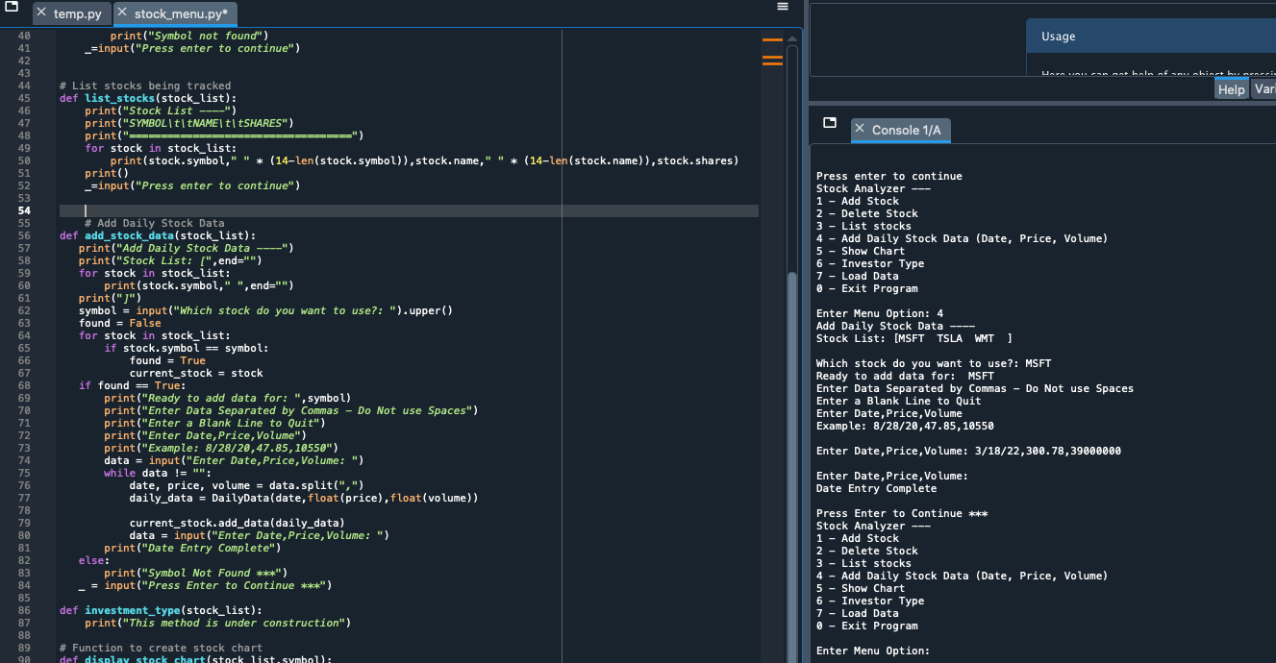
Daily Data

Slide 13
Inheritance
Summary Report
Objectives:
Inherited classes
Unit Tests
Main program

Slide 14
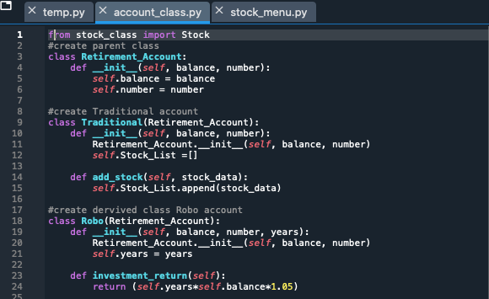
Inherited classes

Slide 15
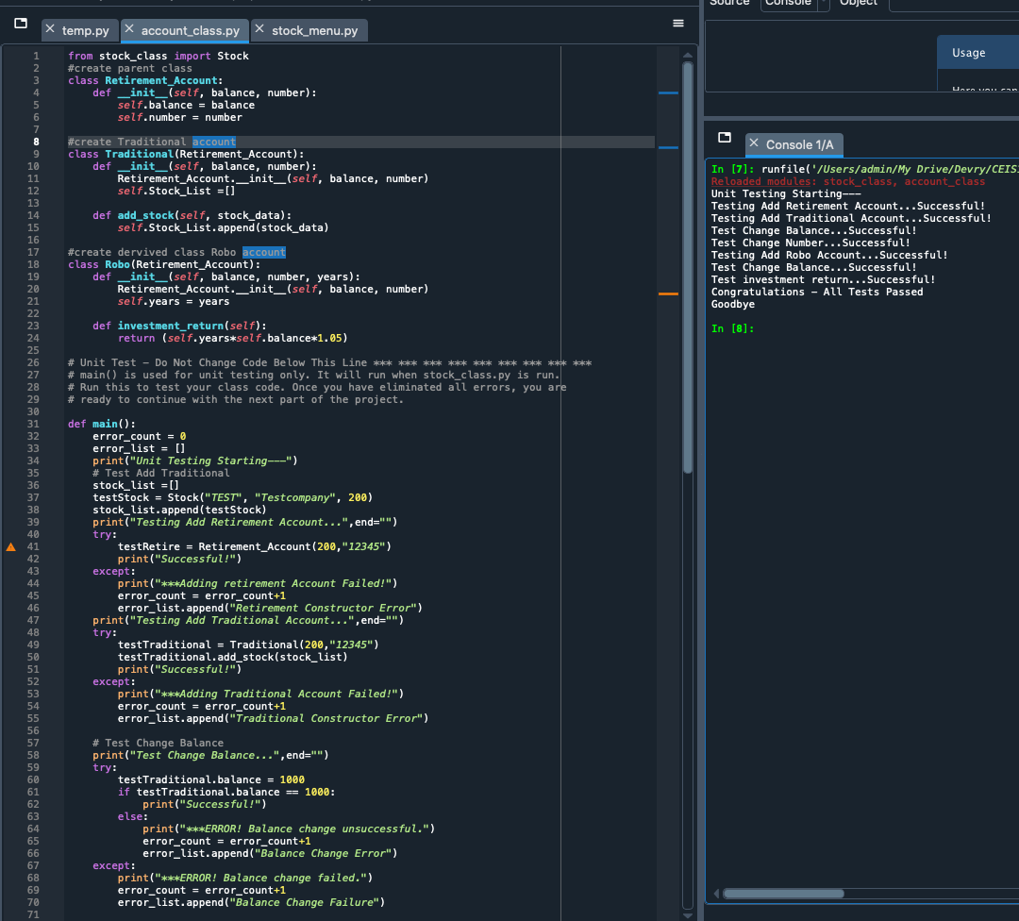
Unit Tests

Slide 16
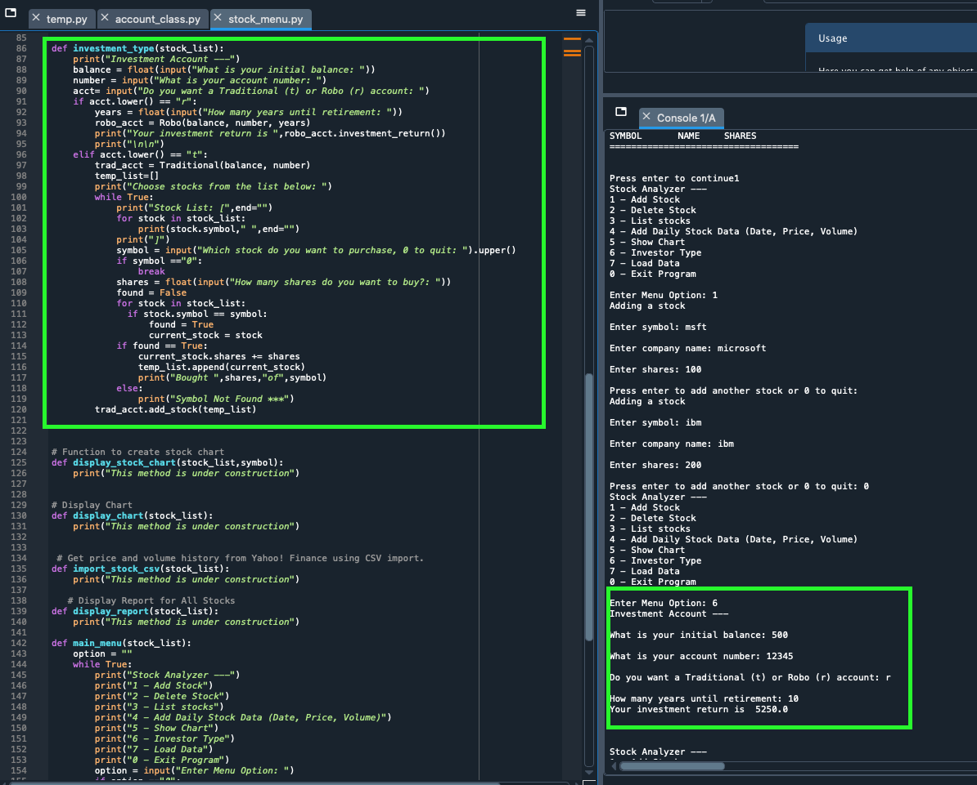
Stock menu program

Slide 17
Creating a Chart
Objectives:
Chart

Slide 18
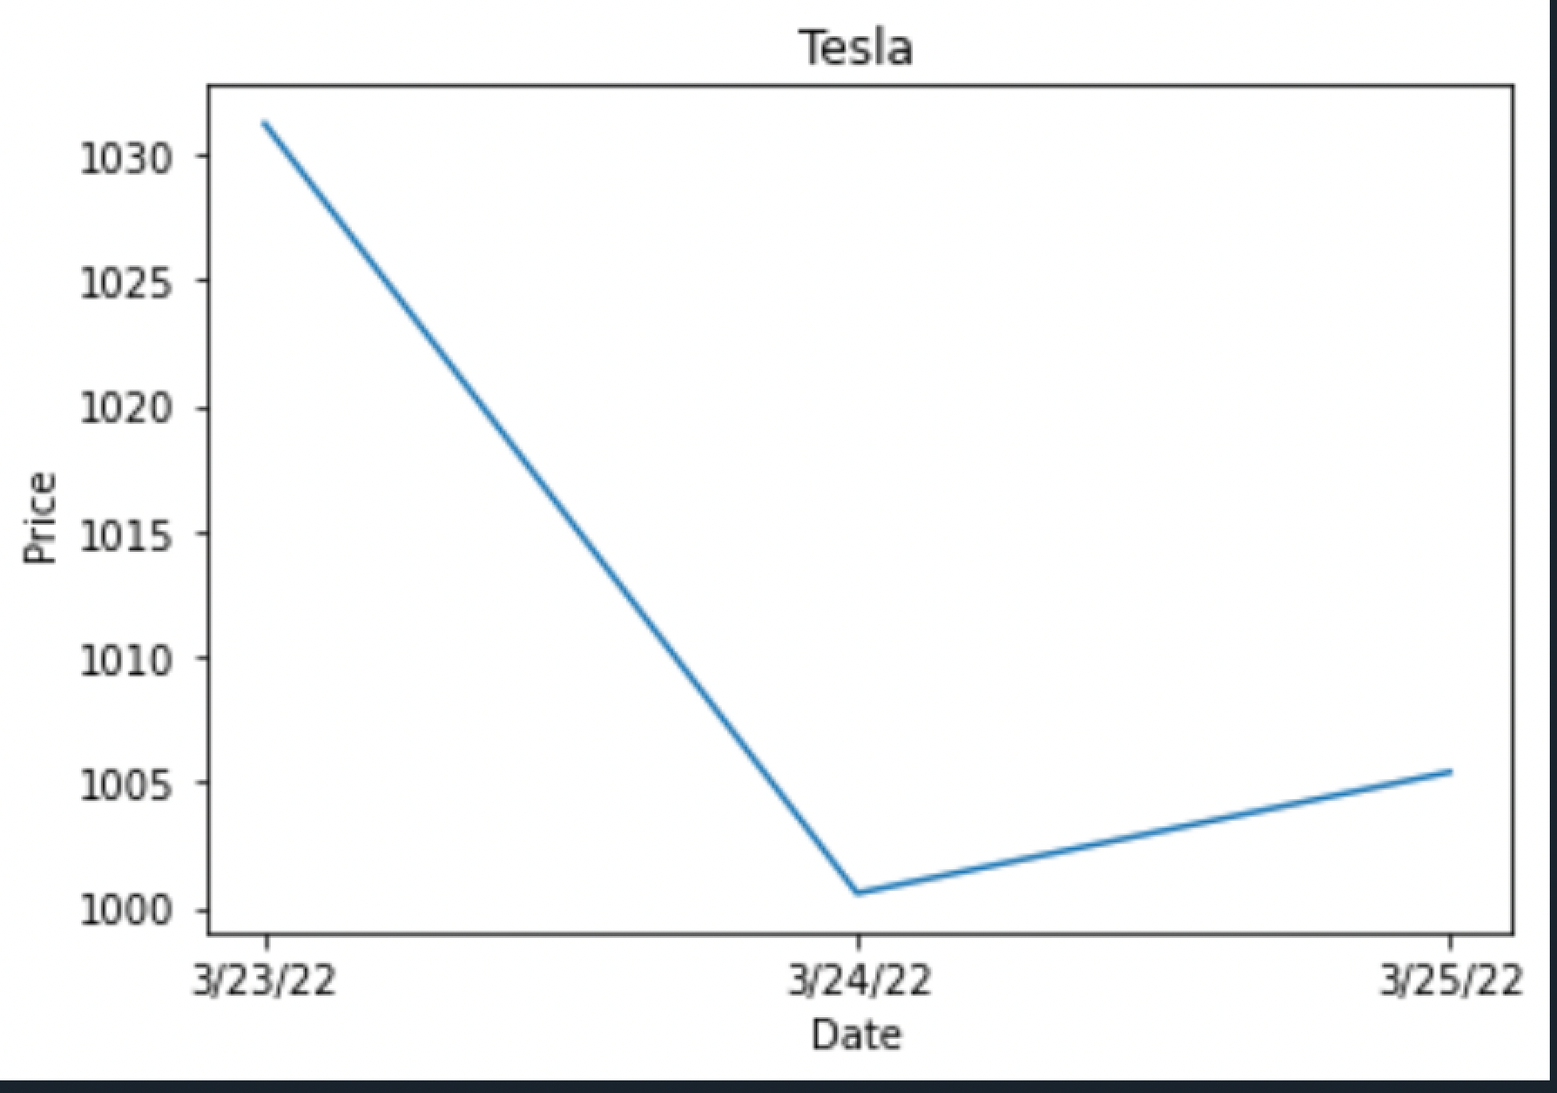
Chart

Slide 19
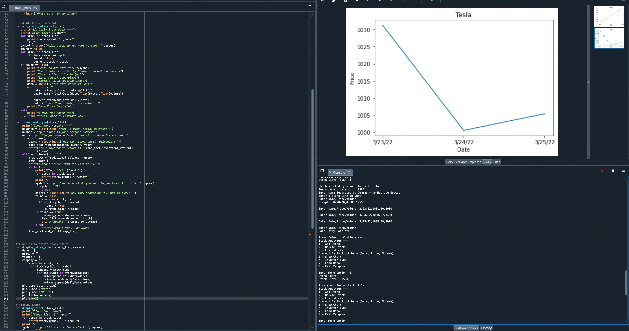
Full Spyder Screenshot (Addition)

Slide 20
Loading Data
Objectives:
File
Importing data

Slide 21
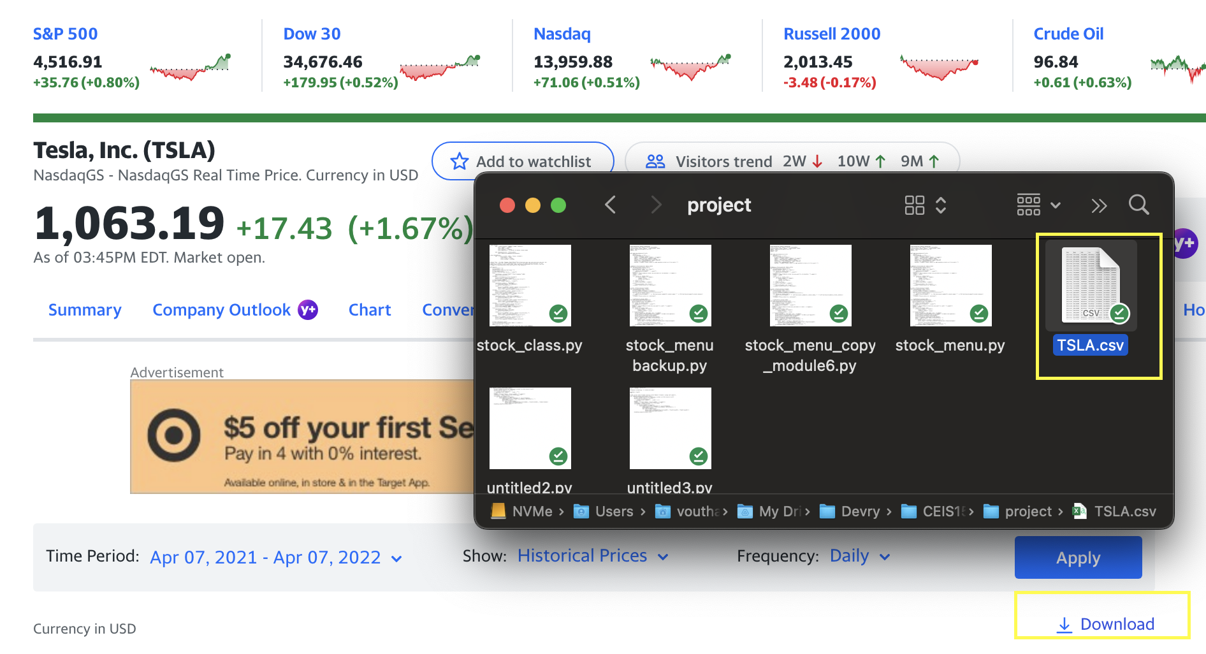
File
Paste a screen shot of the file downloaded from Yahoo finance

Slide 22
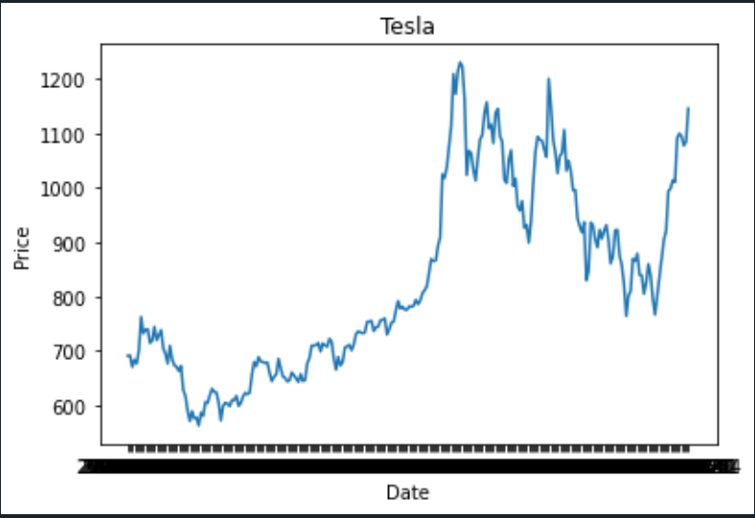
Importing Data

Slide 23
Graphical User Interface
Objectives:
Stocks in GUI
History complete
Report Complete

Slide 24
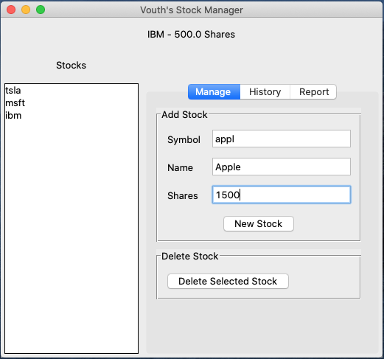
Stocks in GUI

Slide 25
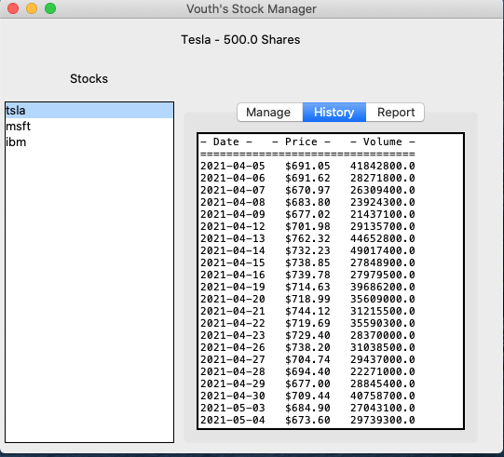
History Tab

Slide 26
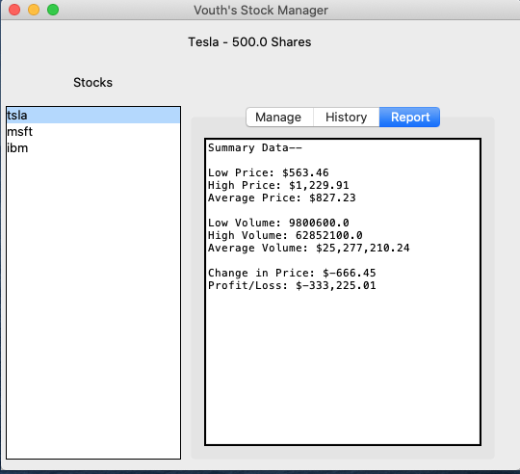
Report Complete

Slide 27
What I Learned from the Project
Programming is imaginative and can be tailored based on the requirements of the individual or organization.
Stock list program allowed me to use live data to understand actual stock trends of major companies.
Add-on packages allow for graphical user interface integration and ease of usage when implemented properly

Slide 28
Career Skills Learned
Networking/
Connectivity
Coding/
Programming
Automation

Slide 29
Conclusion
Programming with objects can be applied to real world applications in many different aspects.
This simple project is a prime example of how Programming has positively impacted the financial network.
The possibilities of programming are endless and can potentially solve labor, or manually intensive processes.

