Slide 1
NETW191 Information technology and networking
By: Vouthanack Sovann

Slide 2
Introduction
Fundamentals of Networking
Fundaments of Subnetting
Fundamentals of IP Addressing
Connectivity Tests and Basic Network Diagrams

Slide 3
IPv4 Addressing

Slide 4
Preparation
This screenshot should include the terminal window that shows the default gateway IP address.

Slide 5
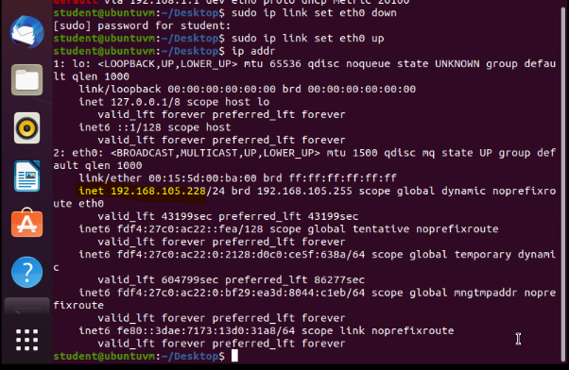
IPv4 Address Assignment
This screenshot should include the Interfaces page that shows the new IPv4 address on the LAN interface.

Slide 6
Connectivity Testing

Slide 7
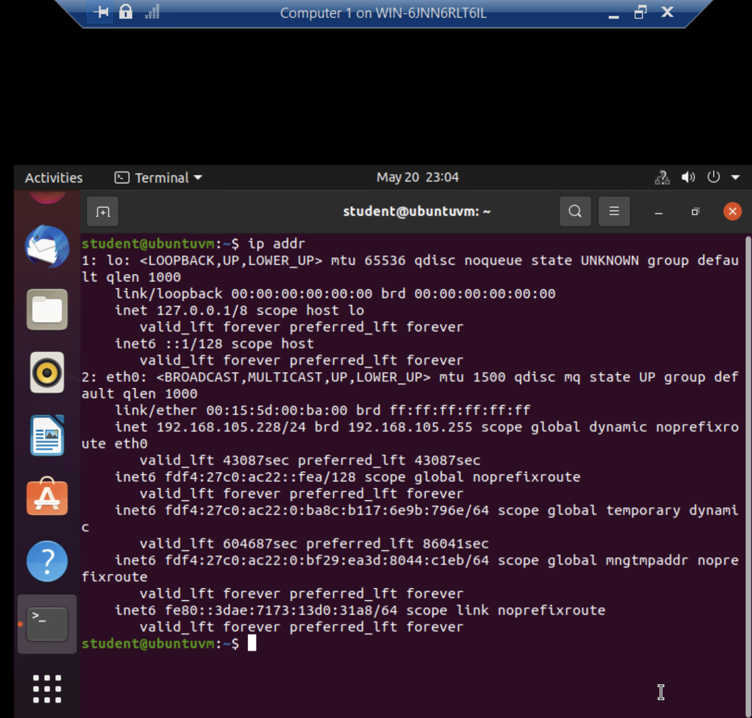
Dynamic IP Address Assignment
This screenshot should show the IPv4 address of the Computer 1 VM.

Slide 8
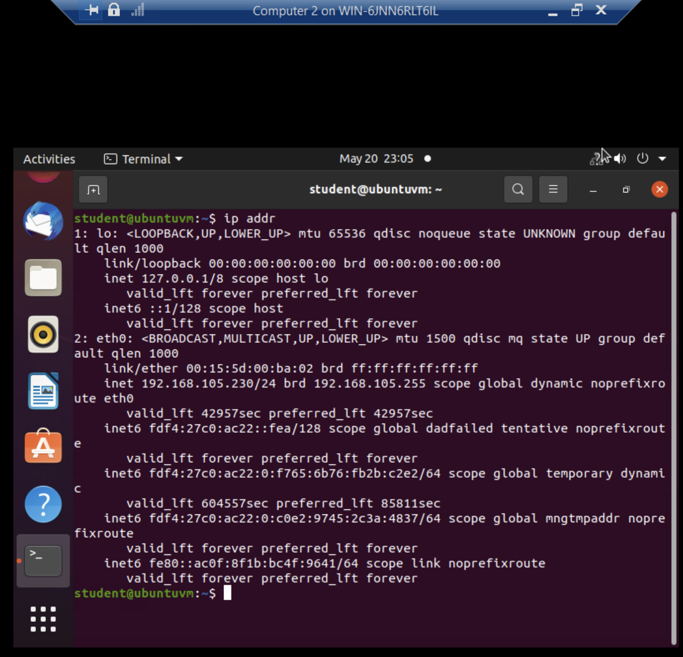
Dynamic IP Address Assignment
This screenshot should show the IPv4 address of the Computer 2 VM.

Slide 9
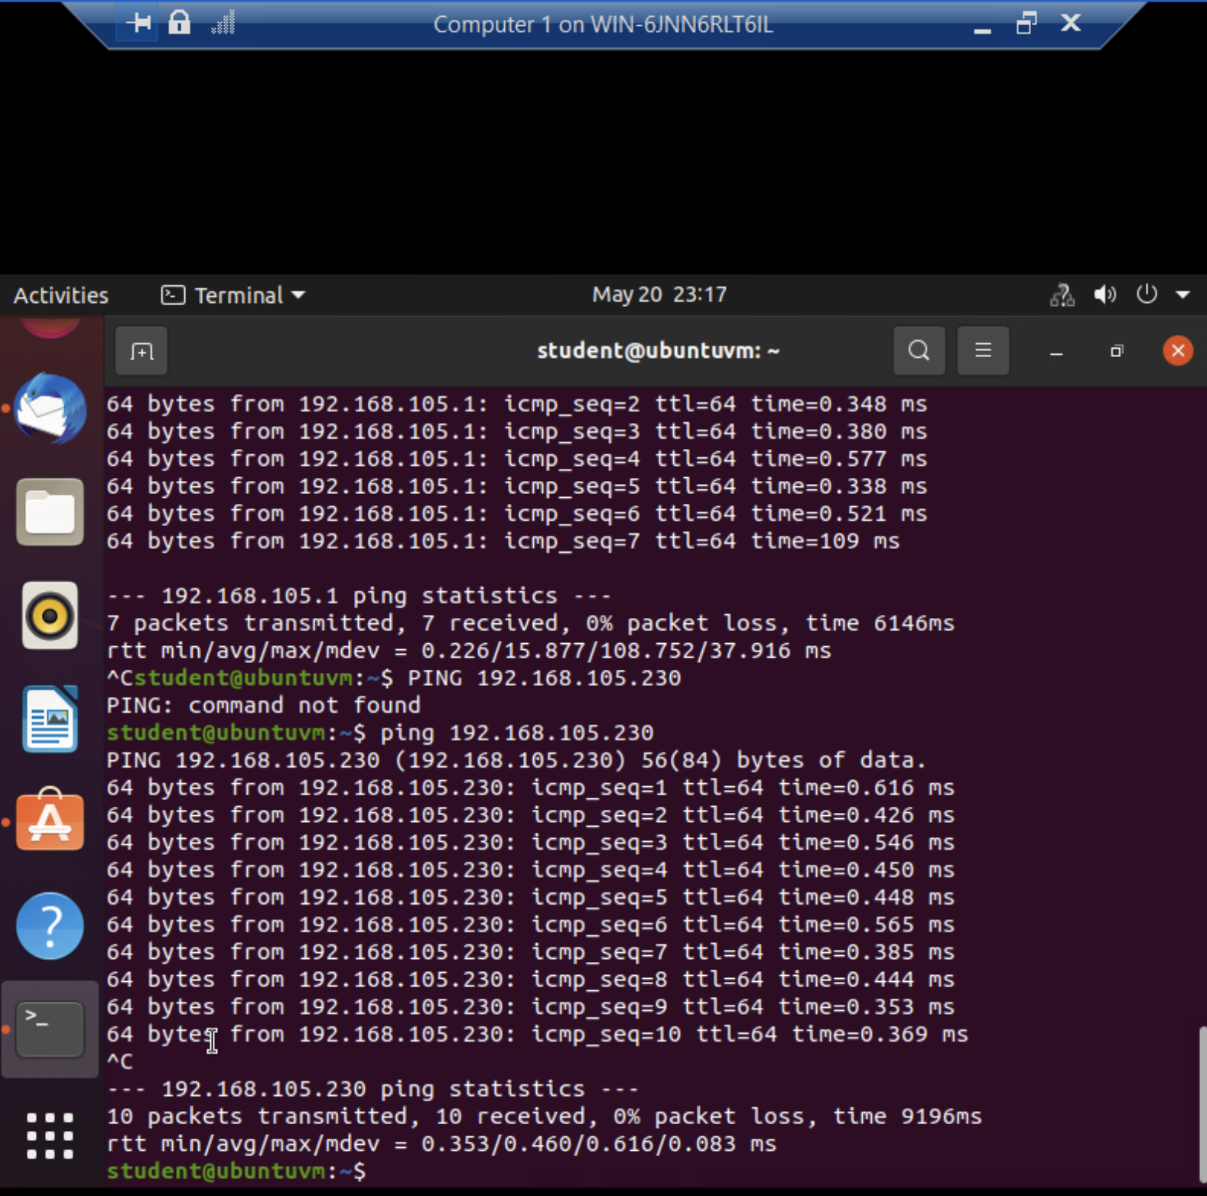
Connectivity
Test
This screenshot should show the connectivity tests between the Computer 1 VM and the other two devices (i.e., the SOHO Router VM and Computer 2 VM).

Slide 10
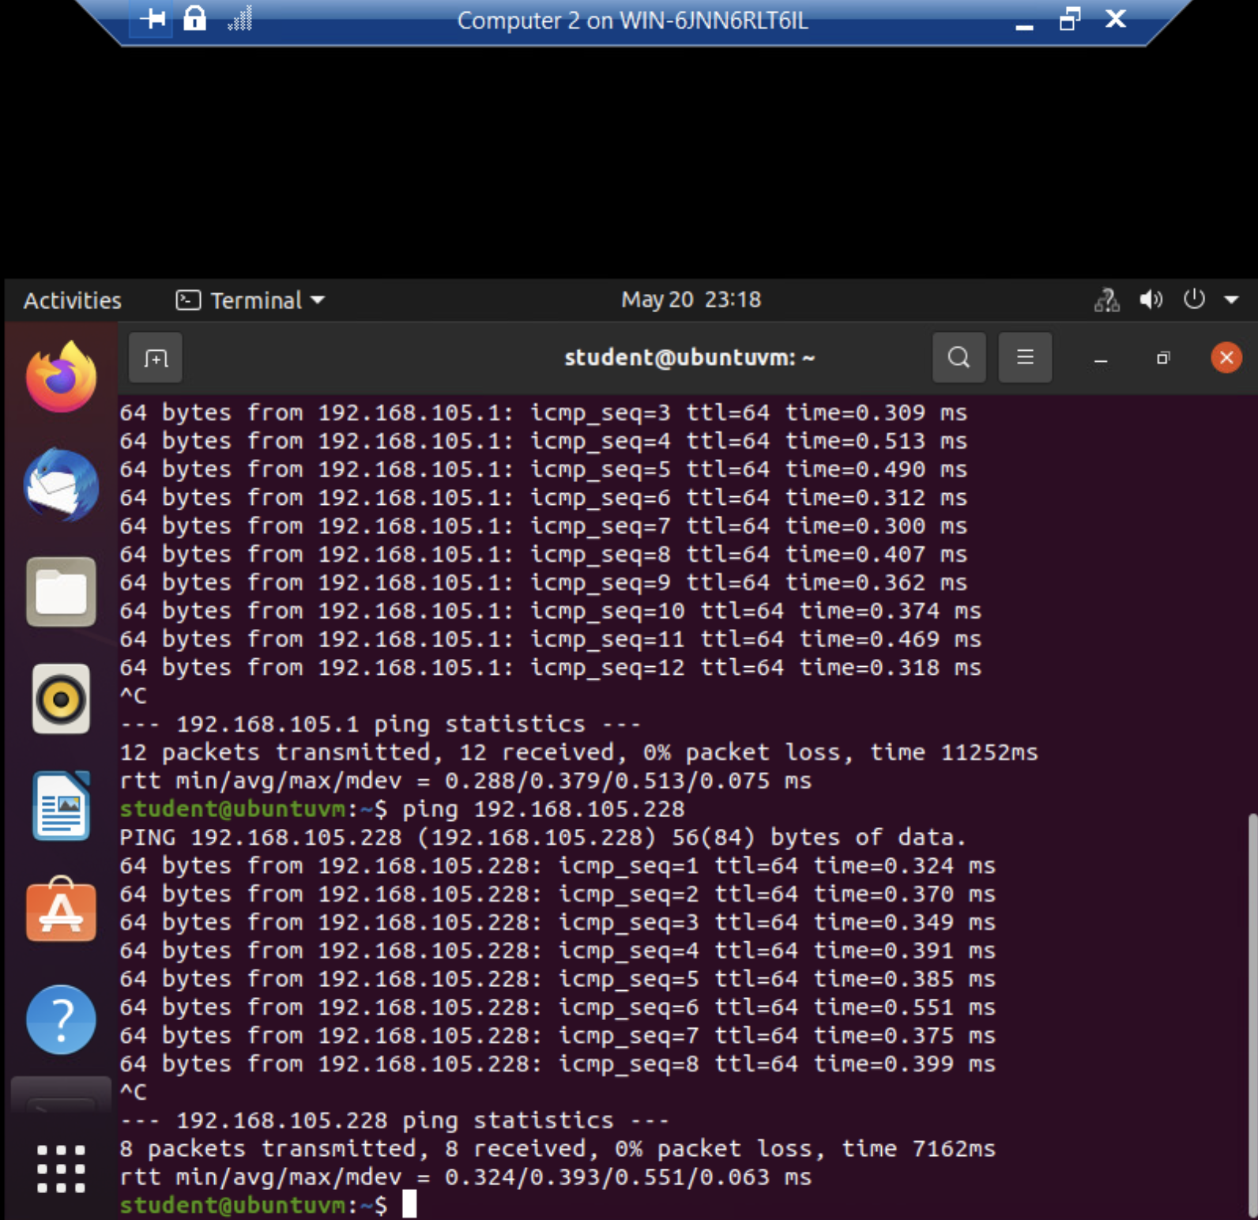
Connectivity Test
This screenshot should show the connectivity tests between the Computer 2 VM and the other two devices (i.e., the SOHO Router VM and Computer 1 VM).

Slide 11
IP Subnetting and Loopback Interfaces

Slide 12
Subnet | Subnet Notation | Network Address | First Usable Host Address | Last Useable Host Address | Broadcast Address
The First Subnet | 192.168.5.0/25 | 192.168.5.0 | 192.168.5.1 | 192.168.5.126 | 192.168.5.127
The Second Subnet | 192.168.5.128/25 | 192.168.5.128 | 192.168.5.129 | 192.168.5.254 | 192.168.5.255
This table should include two /25 subnets, listing the subnet notation, network address, first usable host address, last usable host address, and broadcast address of each subnet.
Subnetting Table

Slide 13
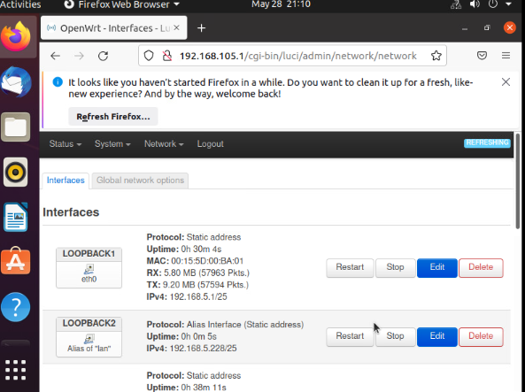
Loopback Interfaces
This screenshot should show both Loopback1 and Loopback2 interfaces and their correct IPv4 addresses.

Slide 14
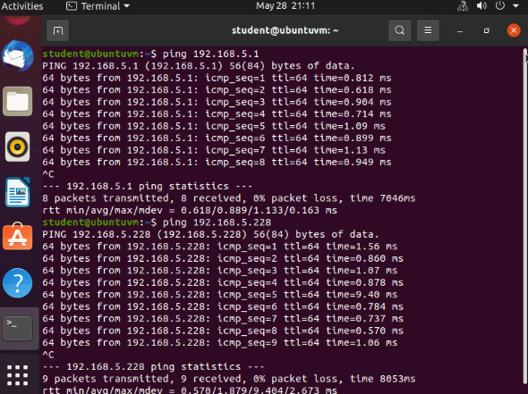
Connectivity Tests
This screenshot should show two successful ping tests from the Computer 1 VM to the Loopback 1 and Loopback 2 interfaces.

Slide 15
Visio Network Diagram

Slide 16
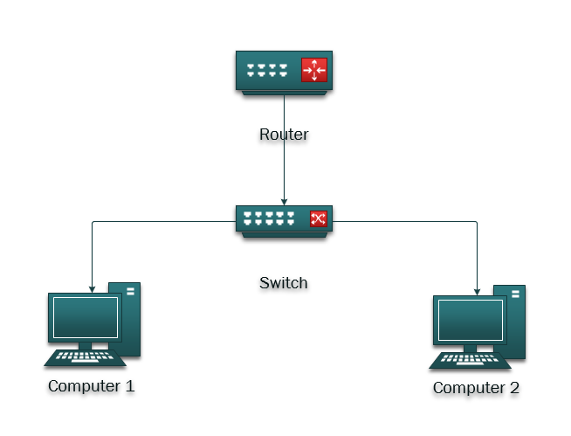
Microsoft Visio Network Diagram
This diagram should illustrate the interconnection of the Computer 1 VM, the Computer 2 VM, and the SOHO Router VM.

Slide 17
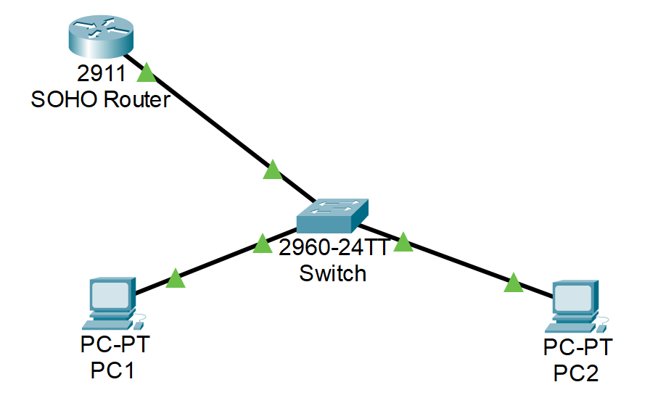
Alternate
Network Diagram
(Packet Tracer)
This diagram should illustrate the interconnection of the Computer 1 VM, the Computer 2 VM, and the SOHO Router VM.

Slide 18
SOHO Wireless Network Security

Slide 19
SOHO Wireless Network Security
1. What are the factory default username and password of a TP-Link router? Why is it important to change the default username and password of a SOHO router?
Answer: admin / admin
There is a high probability that someone will gain access to router since the default credentials are well known throughout the world.
2. To protect a SOHO wireless network with a small number of devices, which address management method provides more control, configuring the device IP addresses manually (static IP) or using a DHCP server (dynamic IP)? Why?
Answer: DHCP is more manageable / controllable due its ability to restrict certain devices from accessing the router based on MAC address.
3. What does MAC filtering do? If needed, when would you use deny filtering rules and when would you use allow filtering rules? What happens to devices that want to connect, if the “Allow the stations specified by any enabled entries in the list to access” function is enabled but there are no entries in the list?
Answer: MAC filtering permit/deny certain devices from using the router and is treated like an access list, or restriction list.
If MAC filtering is enabled to allow only certain stations, and zero devices are on the list, then no wireless stations will be able to use the access point.

Slide 20
SOHO Wireless Network Security
1. What wireless security settings are displayed on the Wireless Security page? Which one is recommended by the vendor? Why?
Answer:
Security methods
(WPA/WPA2 – Personal or Enterprise, or WEP)
Vendor recommends WPA2-PSK AES, since WEP is weaker.
2. Among the configurations you explored in this module, which one is a true security function? Why?
Answer:
WiFi Security is a security function that allows data to be encrypted with WPA or WPA2. Without this, then the data is at risk of being captured.
3. What would you do to protect your wireless network at home? Why?
Answer:
Use a strong password and periodically monitor unauthorized connections to the router. The current router sends notification to my phone when a new connection is made to my network.

Slide 21
What I Learned
Networking principles.
IP and subnetting fundamentals
Linux configuration capabilities
Network diagram and design

Slide 22
Conclusion
Proper knowledge of networking is crucial to all IT work.
Networking fundamentals is a requirement in most IT sectors.
Networking can be applied in Linux, Mac or Windows Operating Systems with ease.

